Slide 1
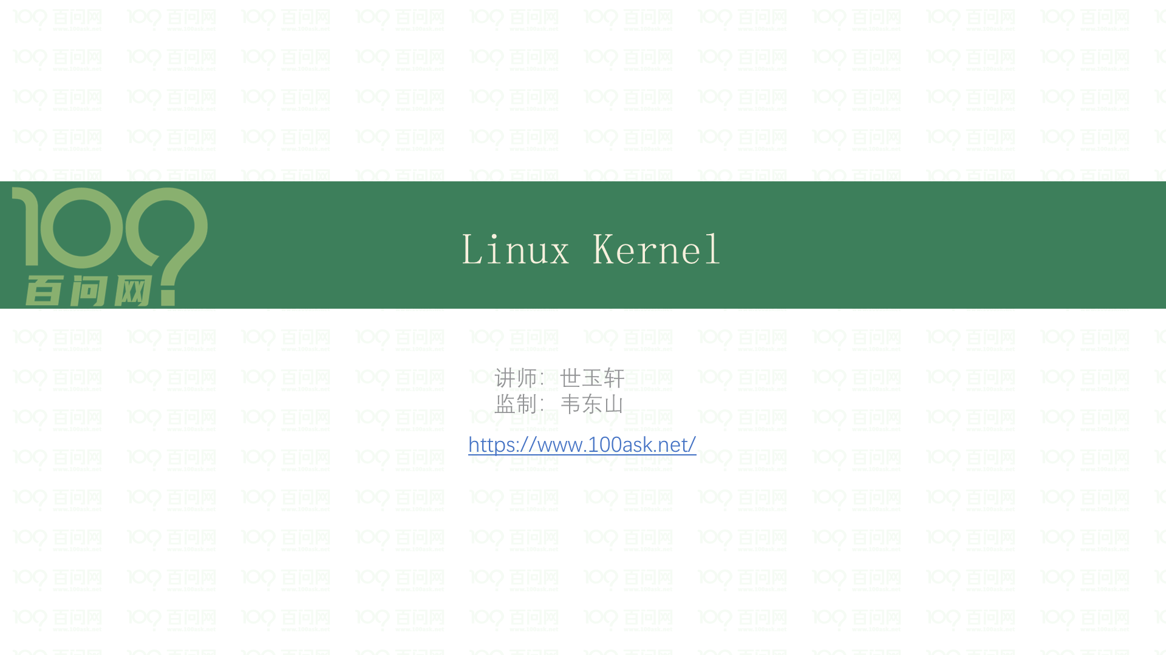

Slide 2
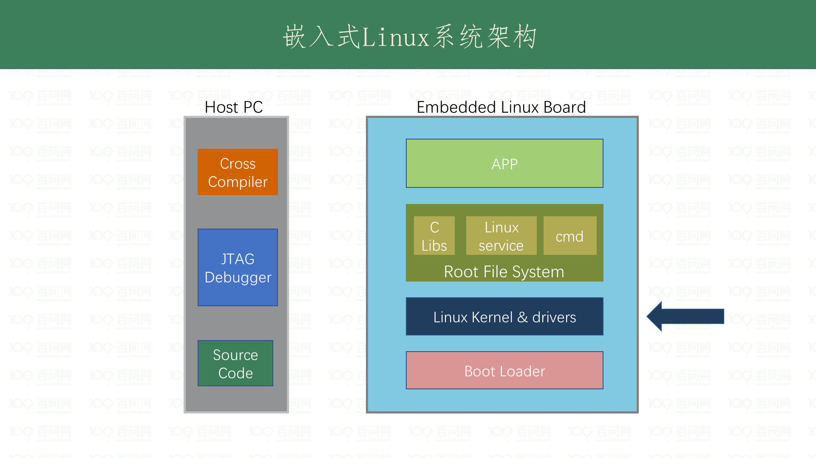

Slide 3
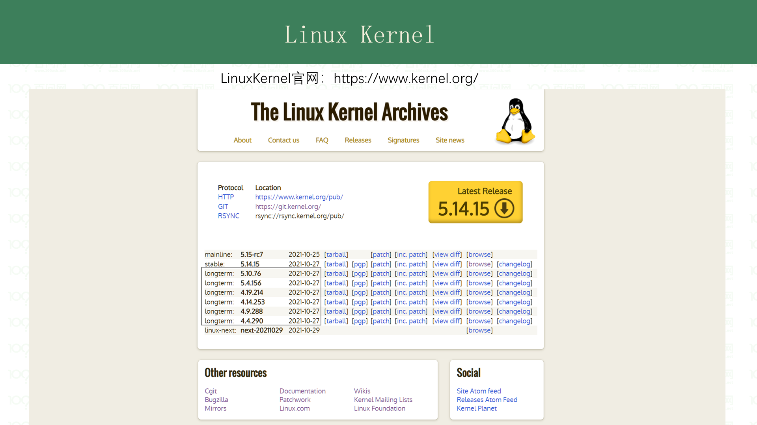

Slide 4
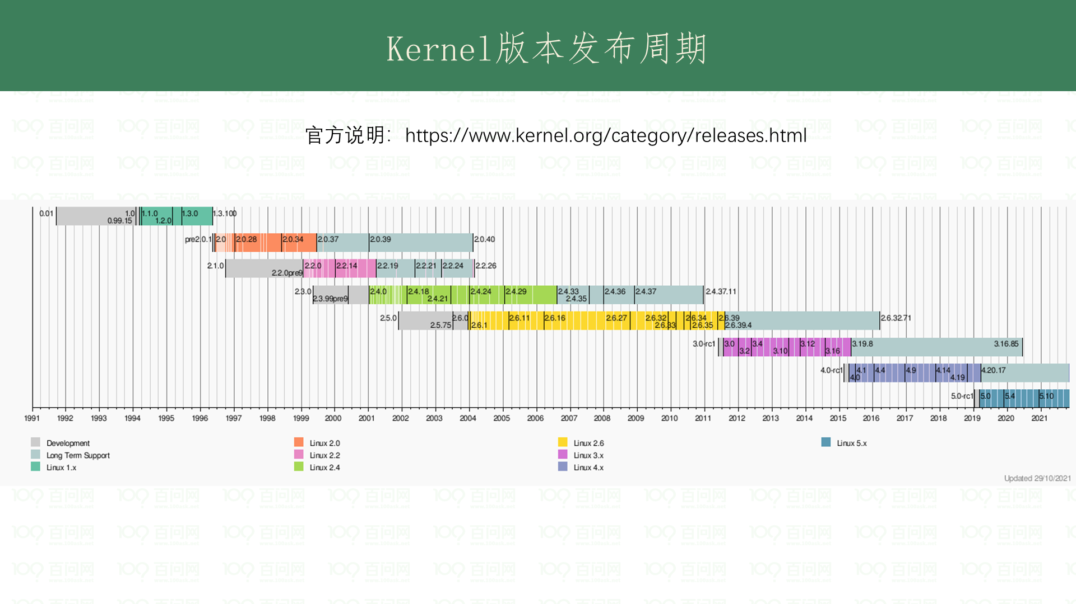
Notes:
https://en.wikipedia.org/wiki/Linux_kernel_version_historyhttps://en.wikipedia.org/wiki/Linux_kernel_version_history

Slide 5
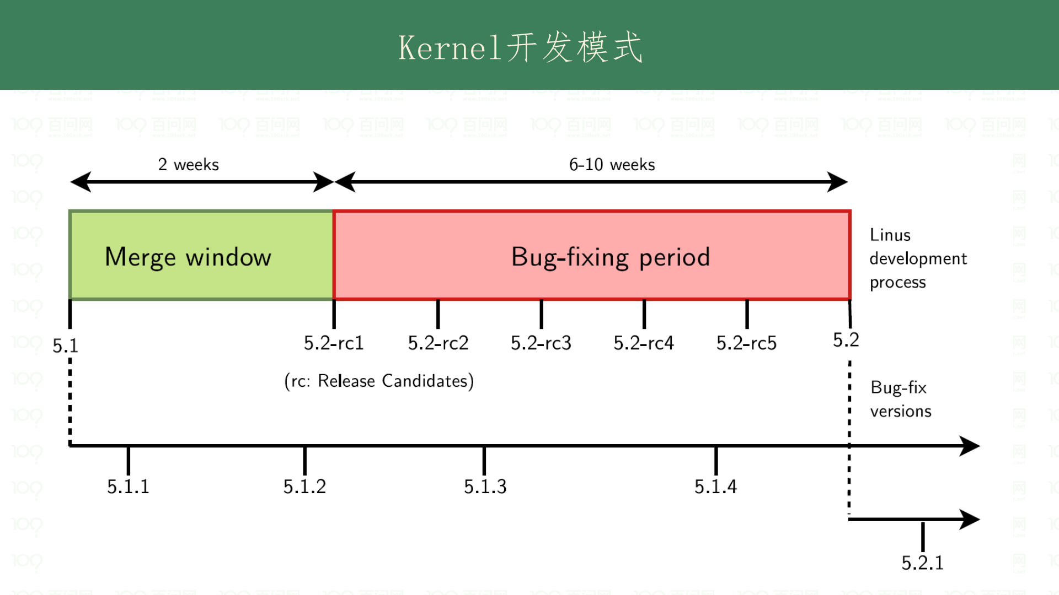

Slide 6
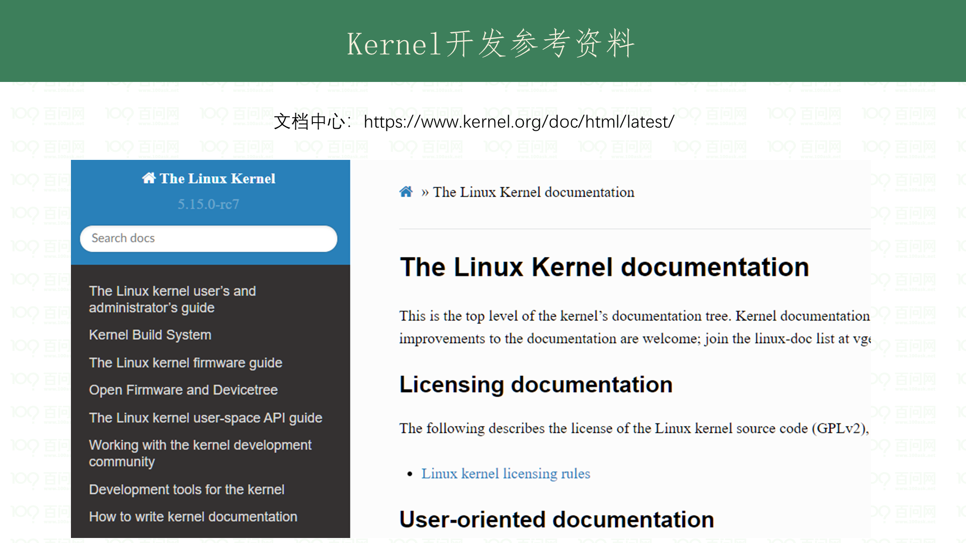

Slide 7
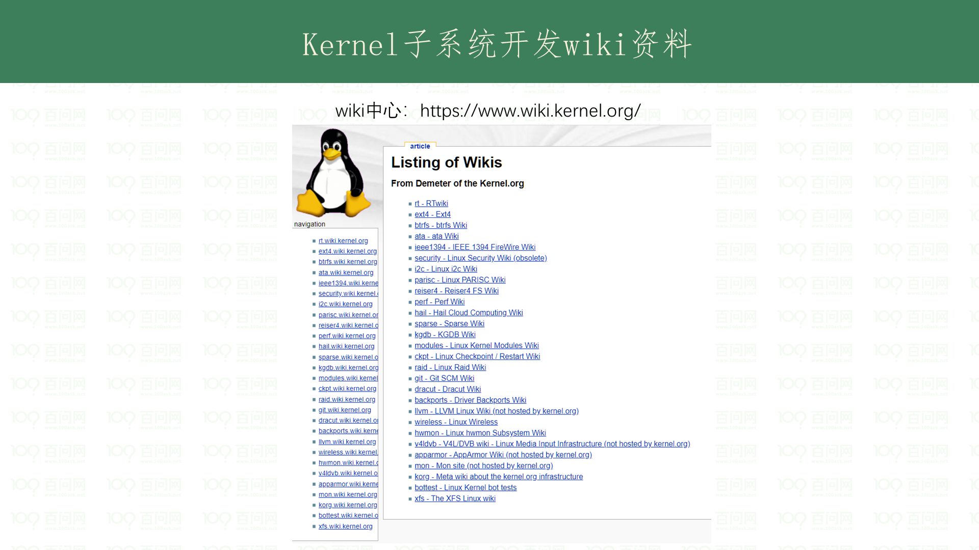

Slide 8
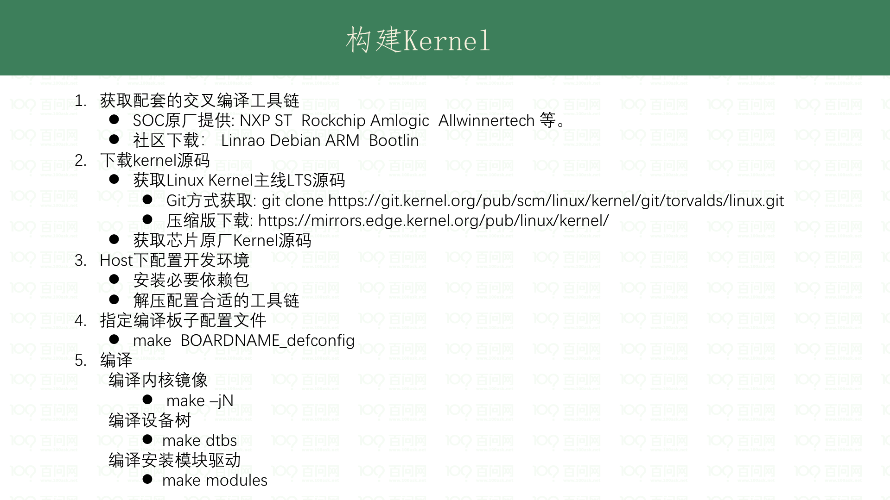
Notes:
sudo apt-get install gawk wget git diffstat unzip texinfo gcc-multilib build-essential chrpath socat libsdl1.2-dev xterm picocom ncurses-dev lzop

Slide 9
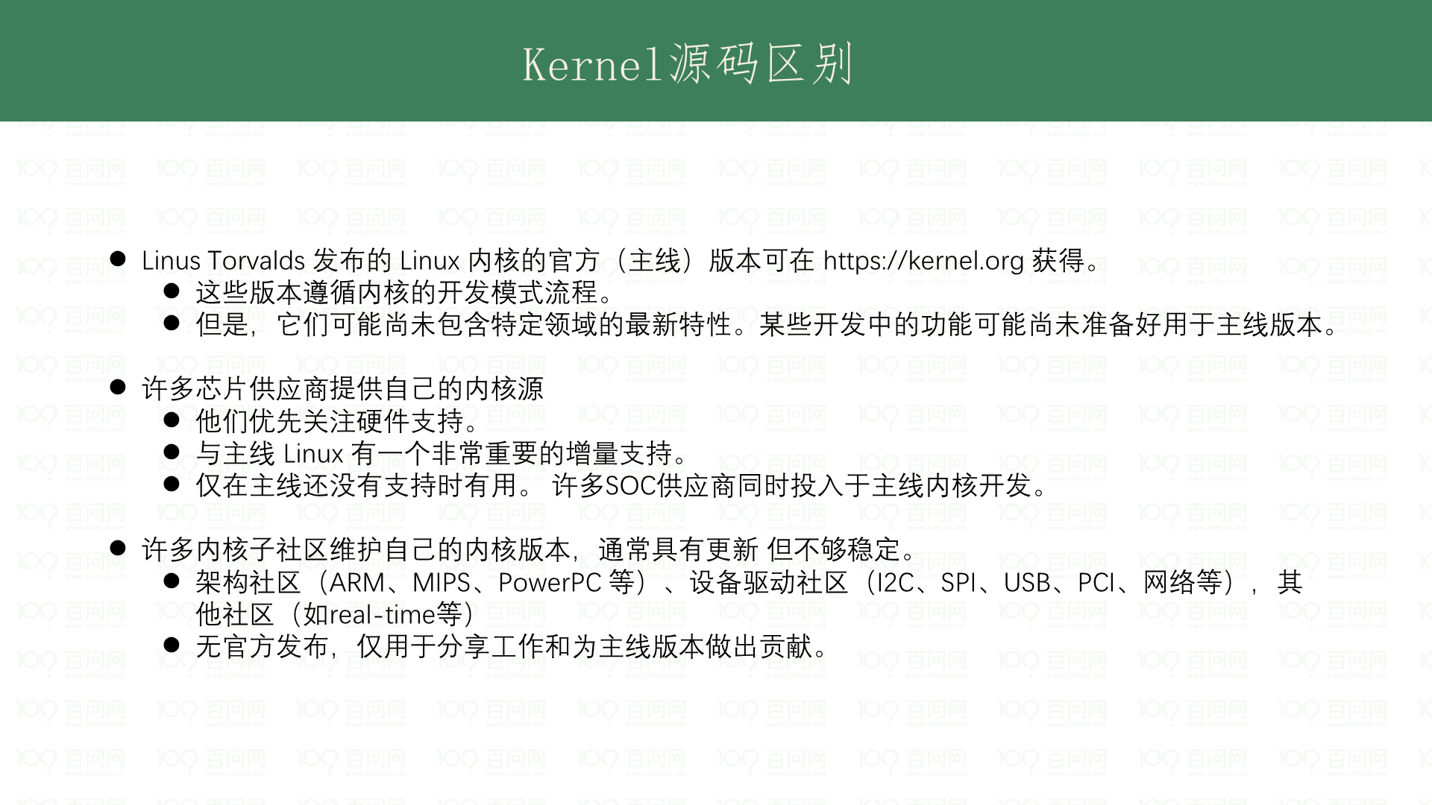

Slide 10
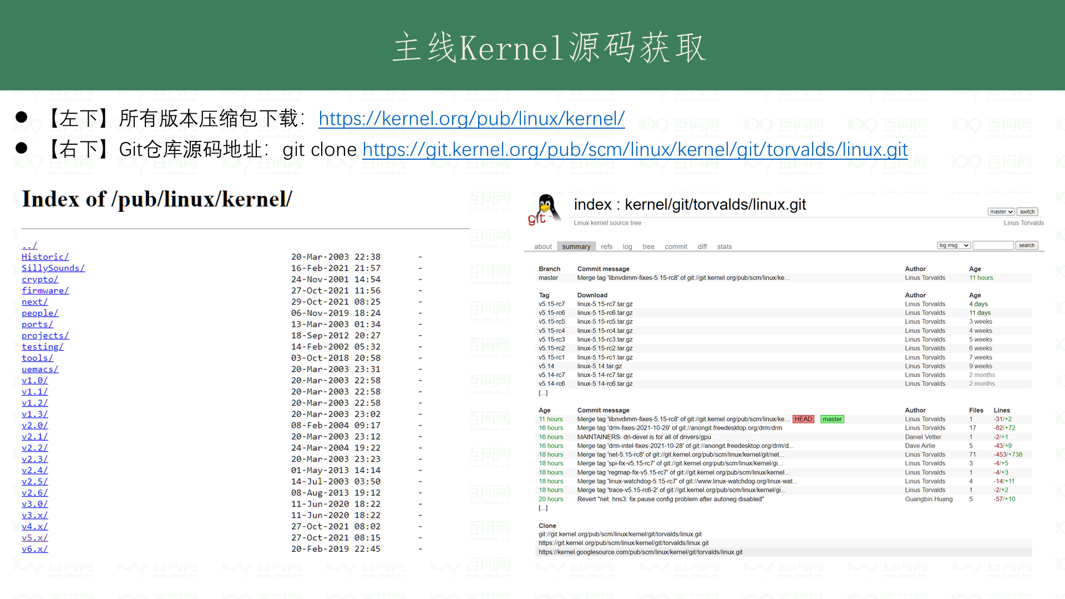
Notes:
教程配套的kernel源码 https://cdn.kernel.org/pub/linux/kernel/v5.x/linux-5.4.158.tar.xz

Slide 11
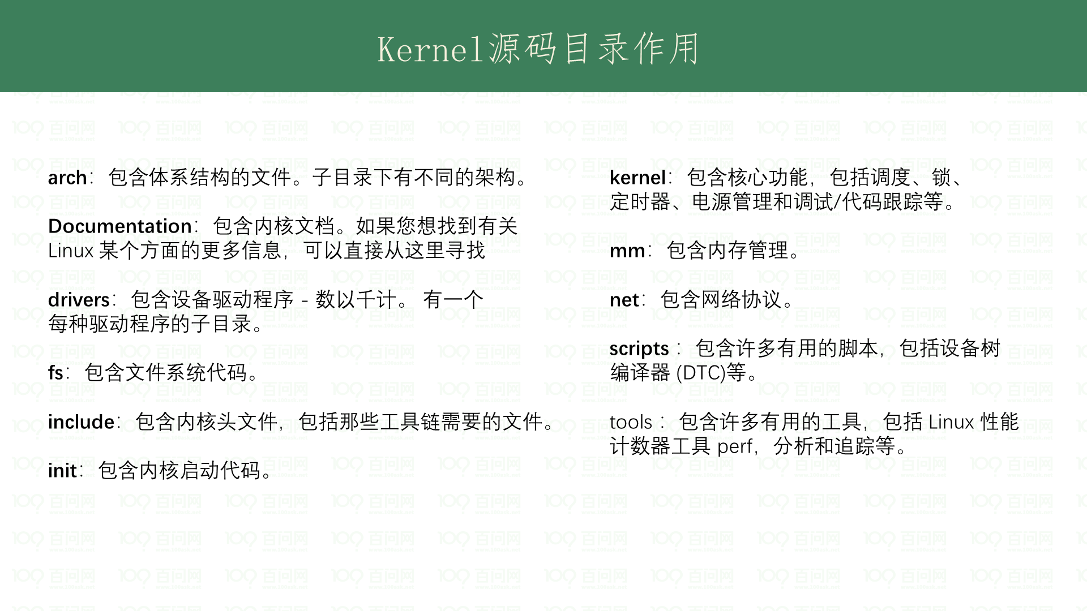

Slide 12
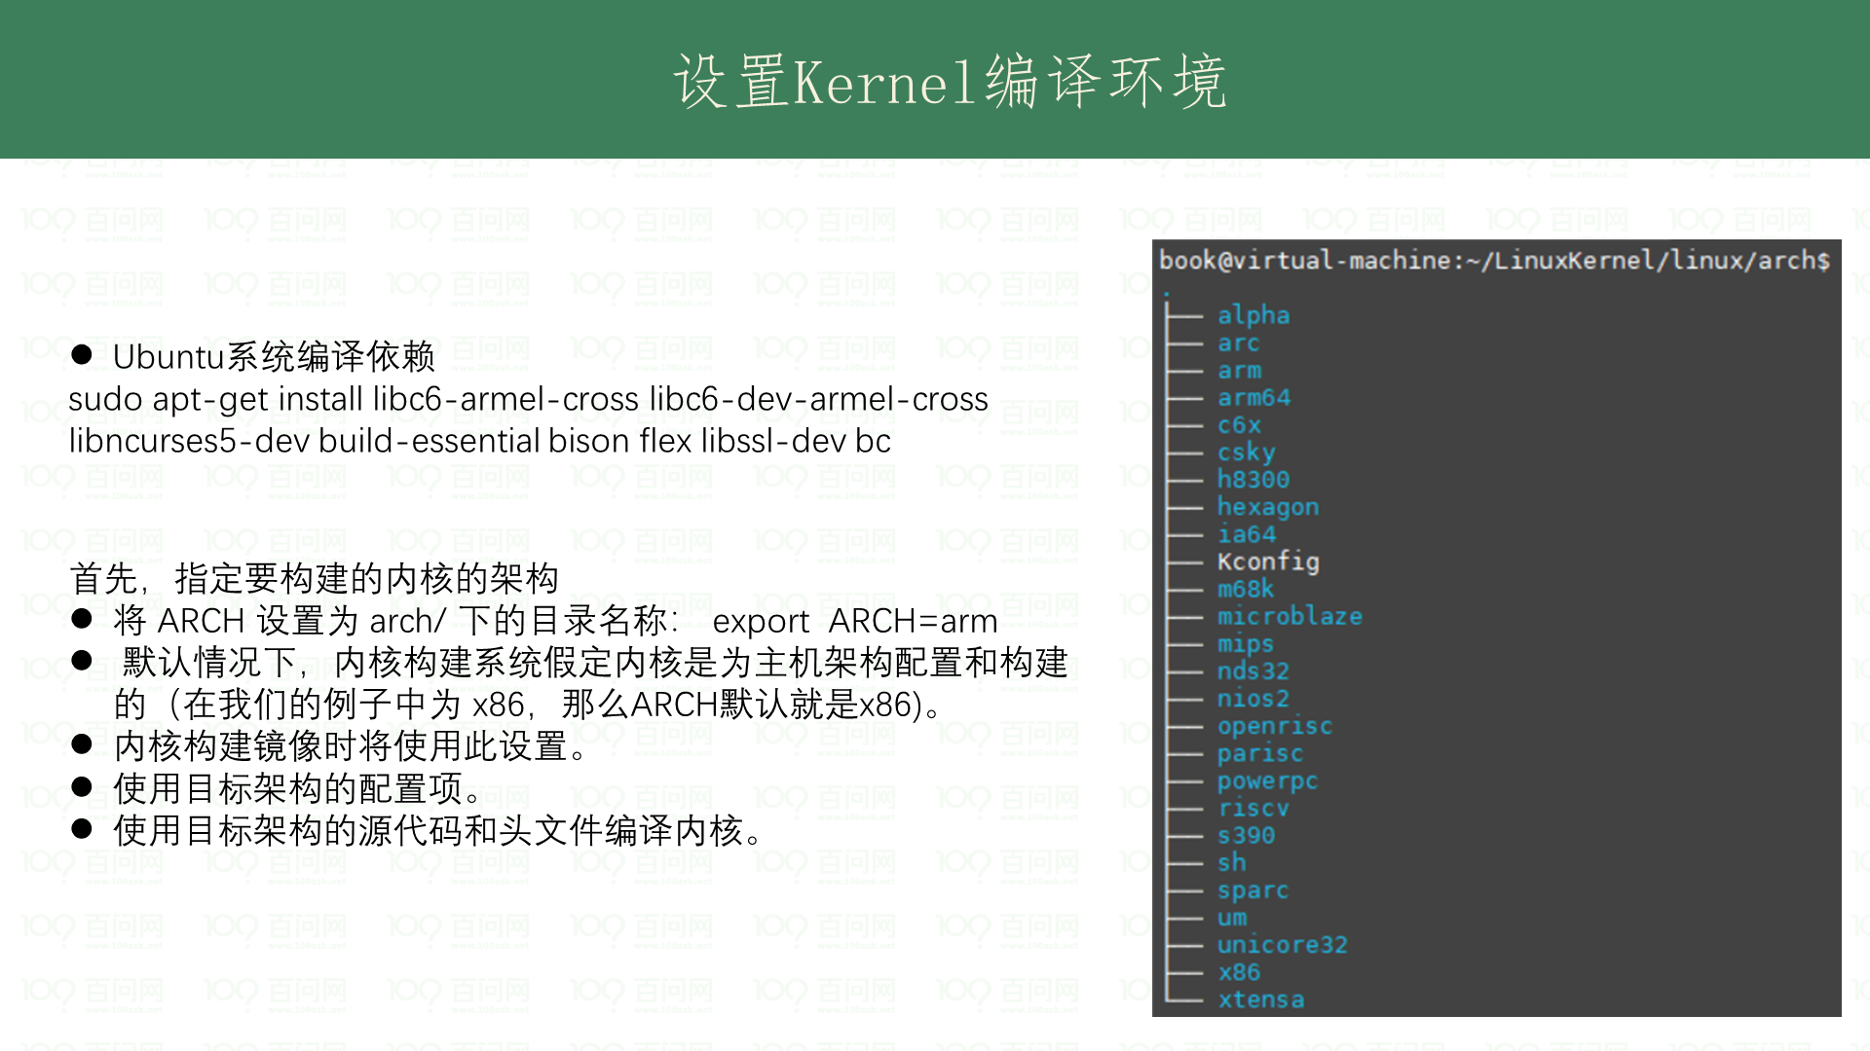

Slide 13
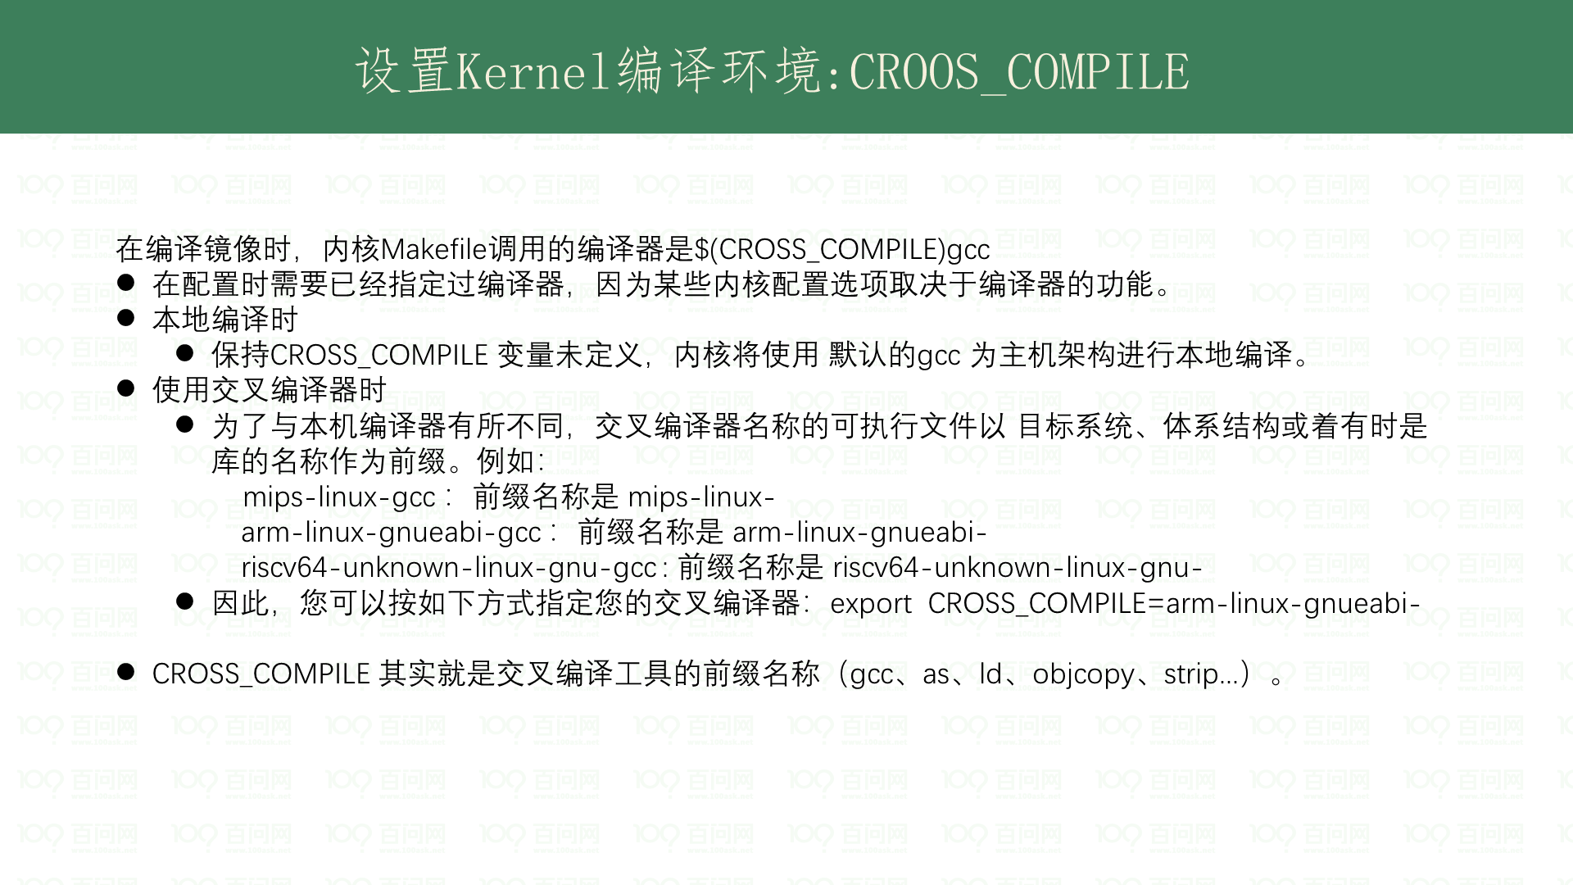

Slide 14
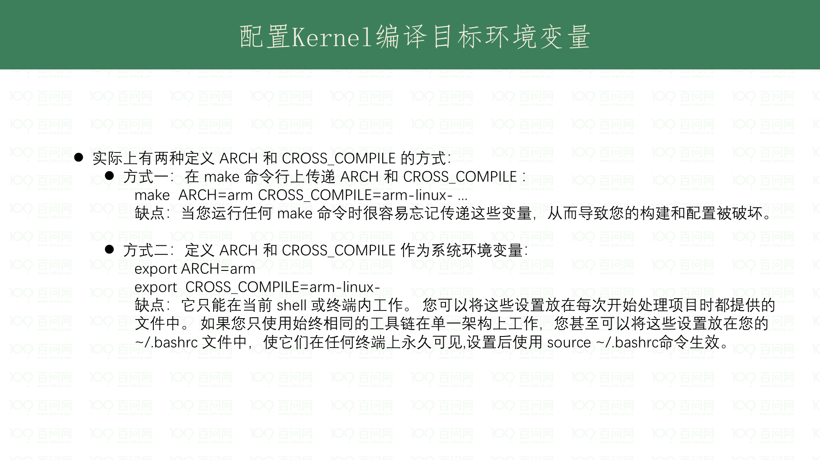

Slide 15
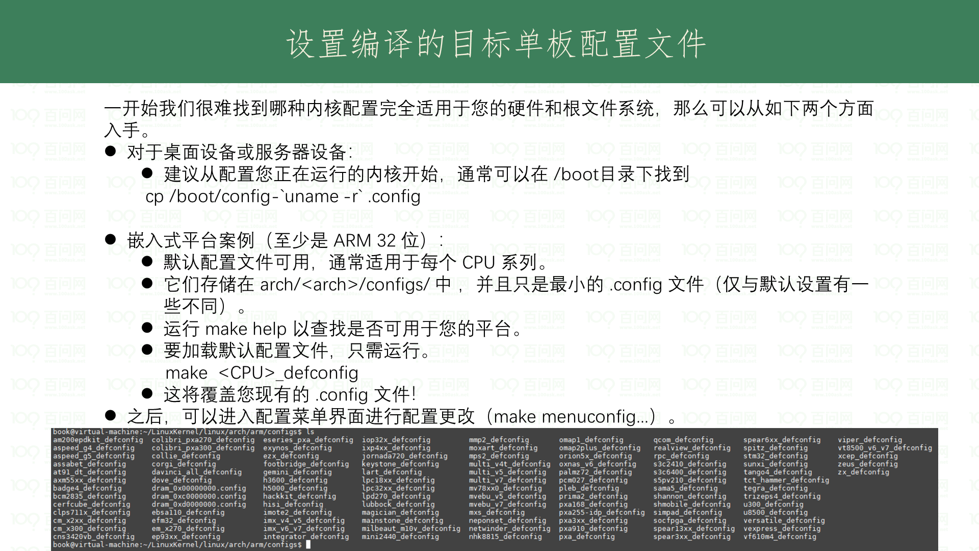

Slide 16
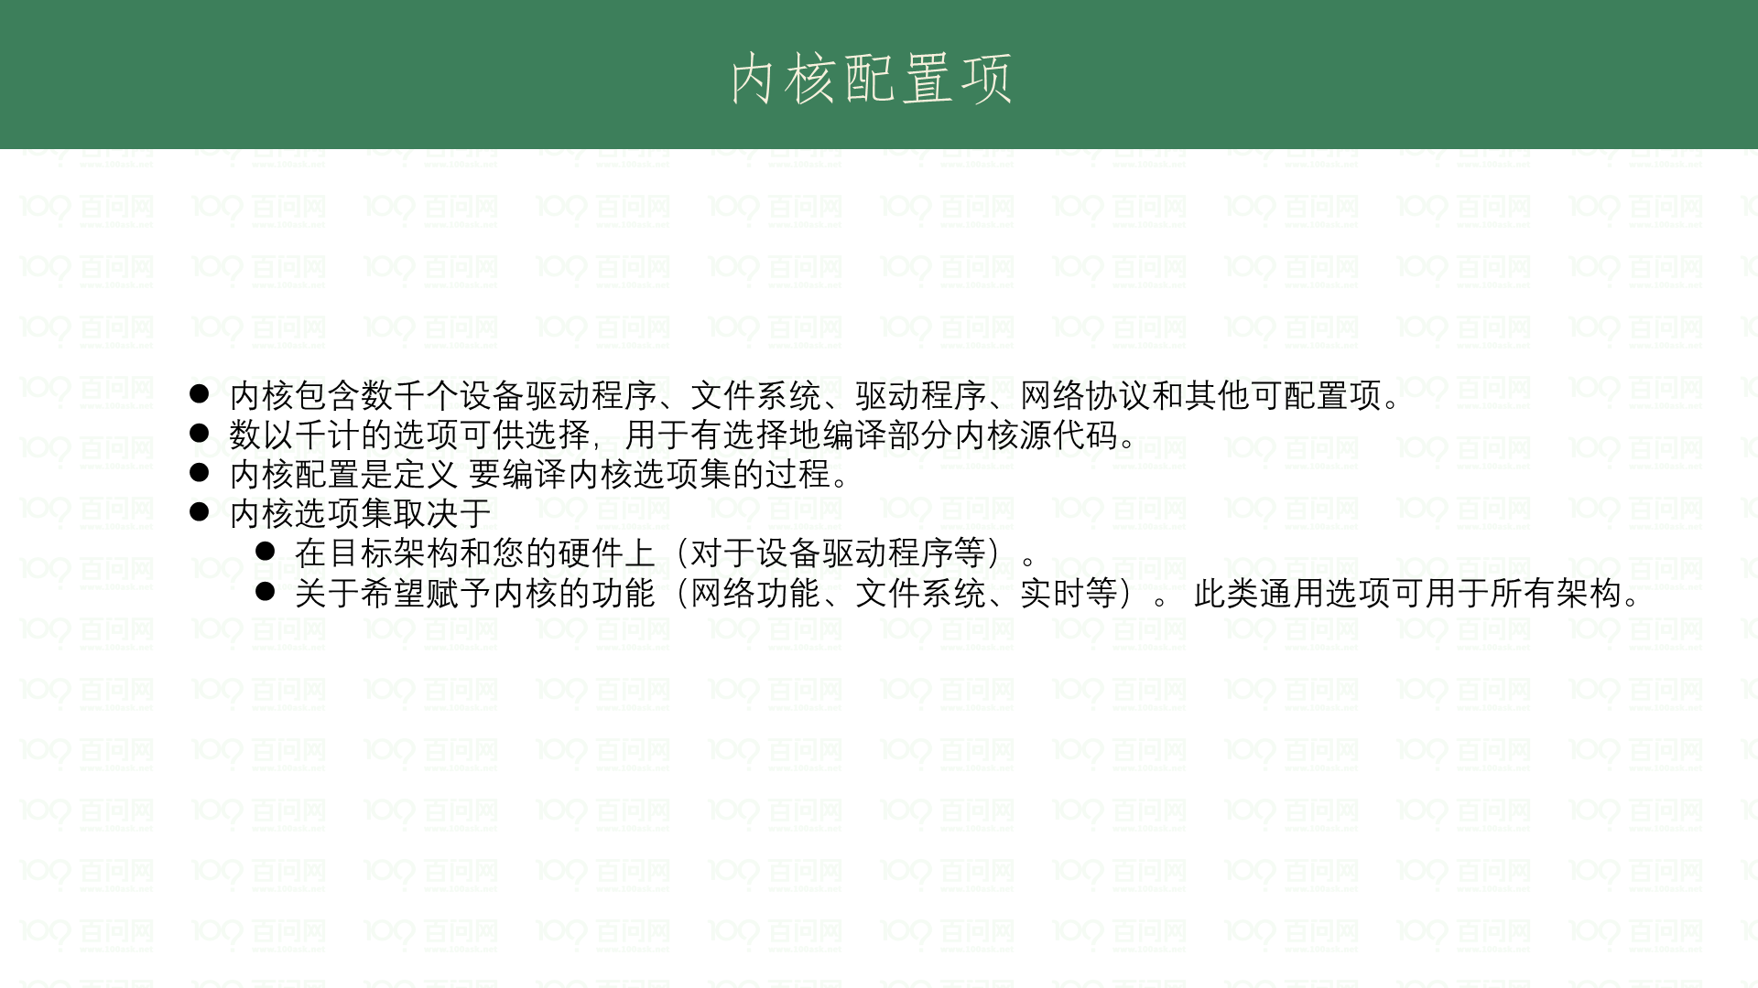

Slide 17
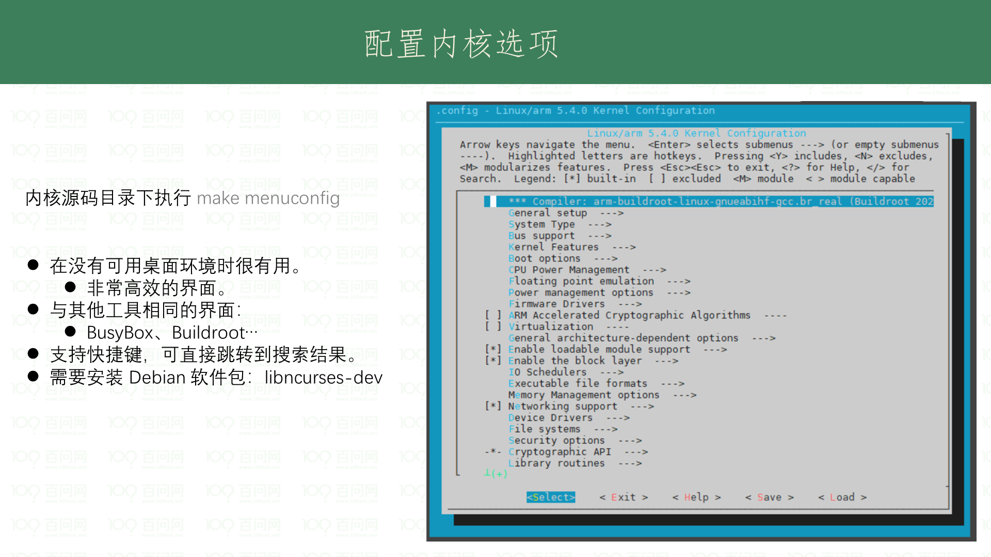

Slide 18
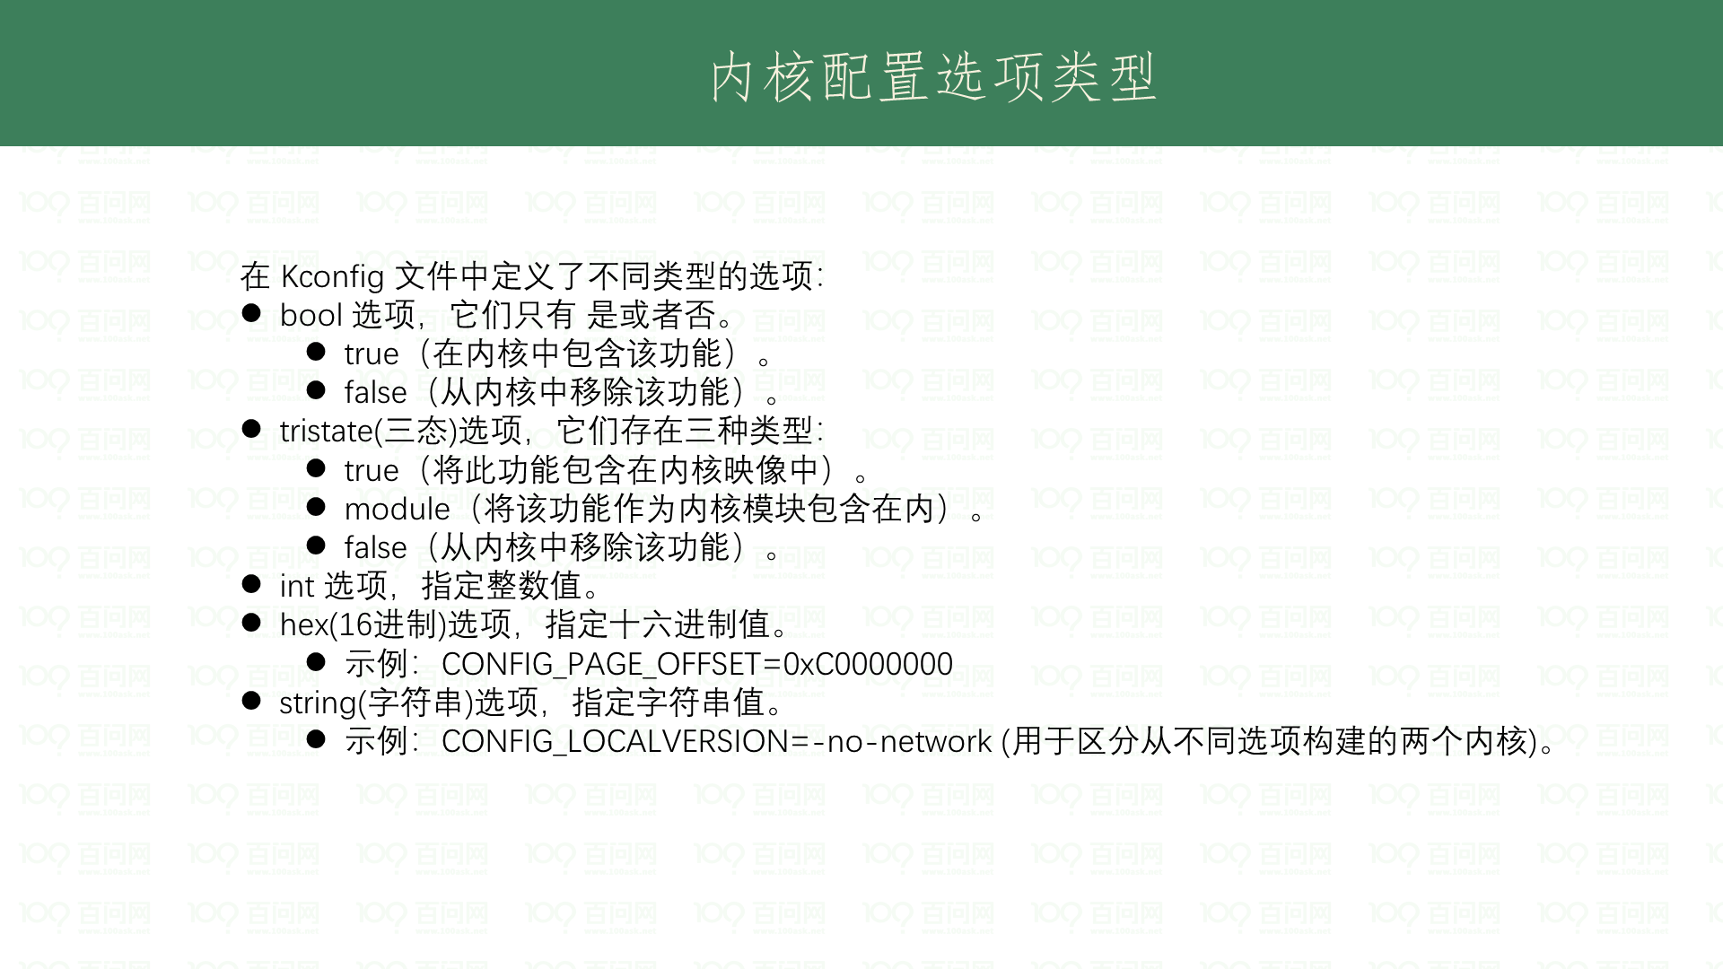

Slide 19
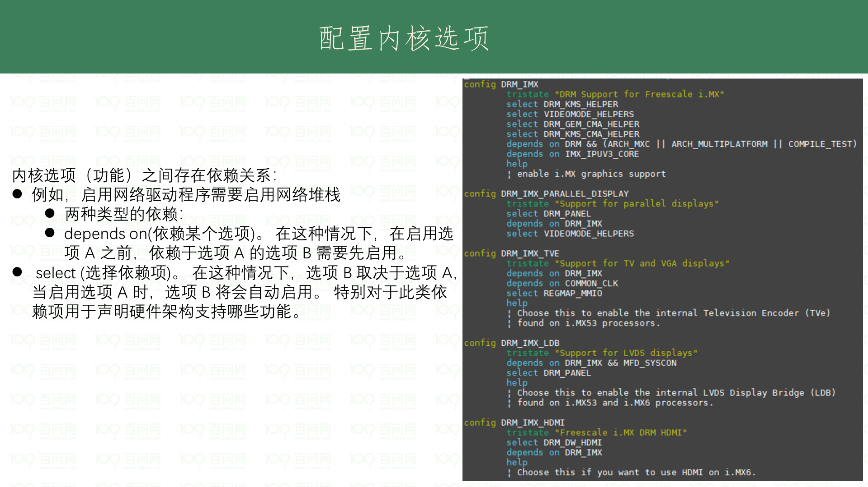

Slide 20
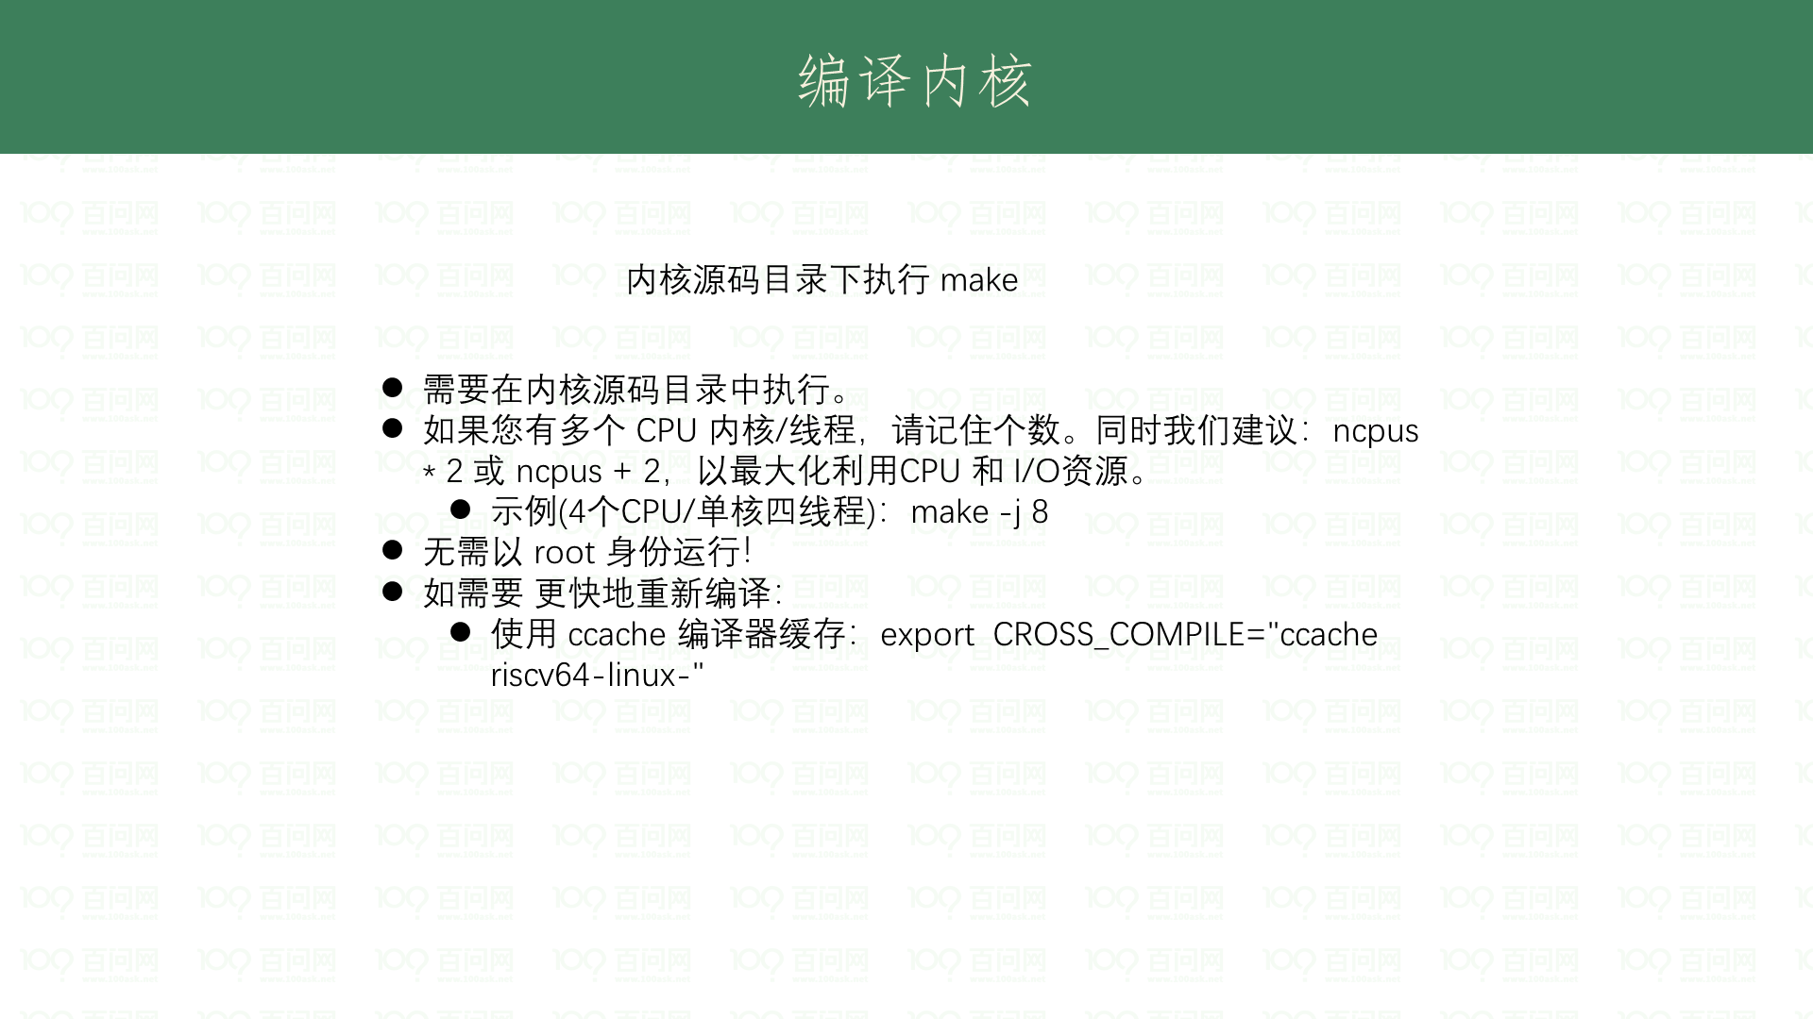

Slide 21
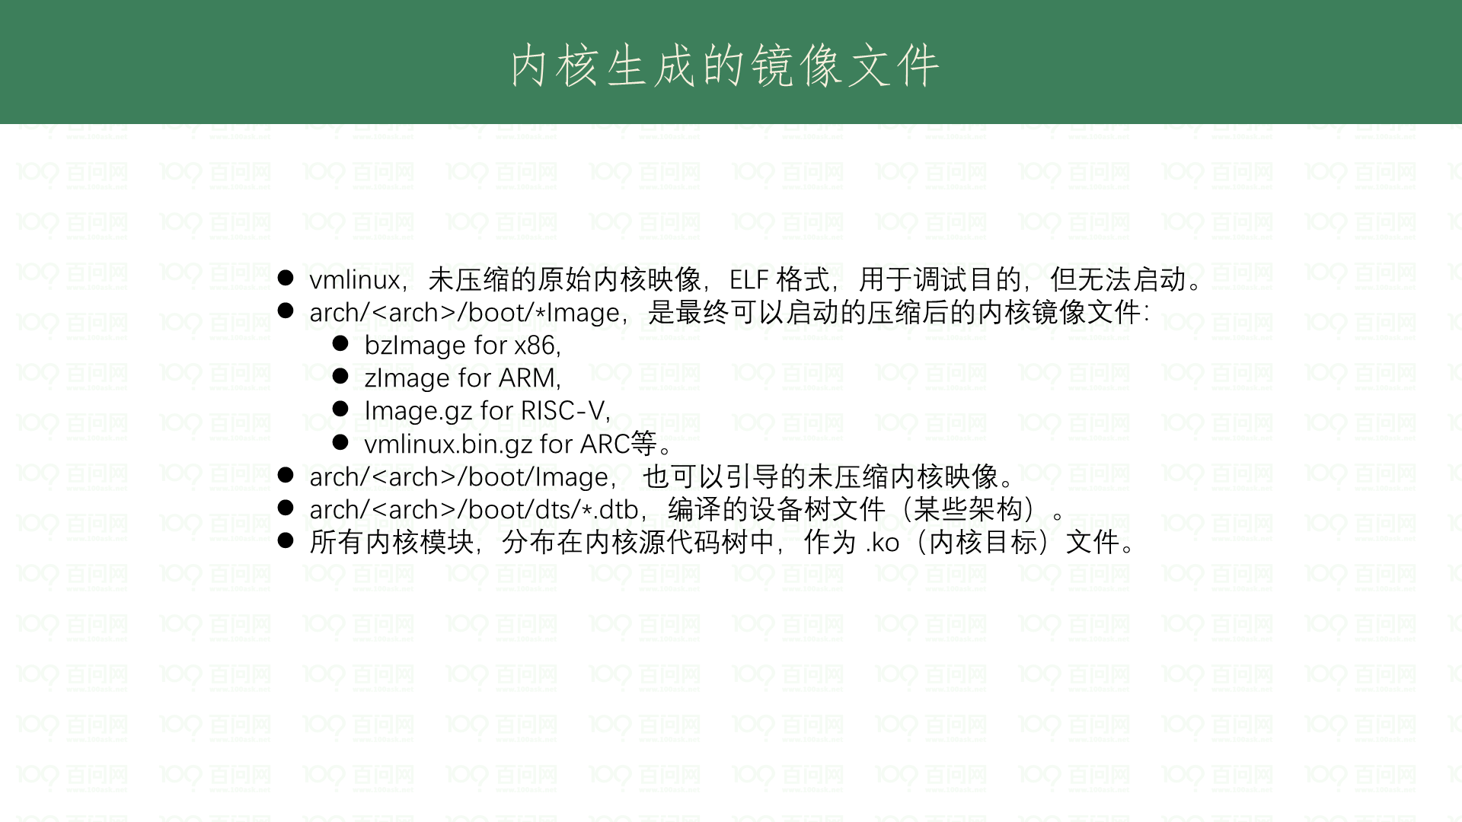

Slide 22
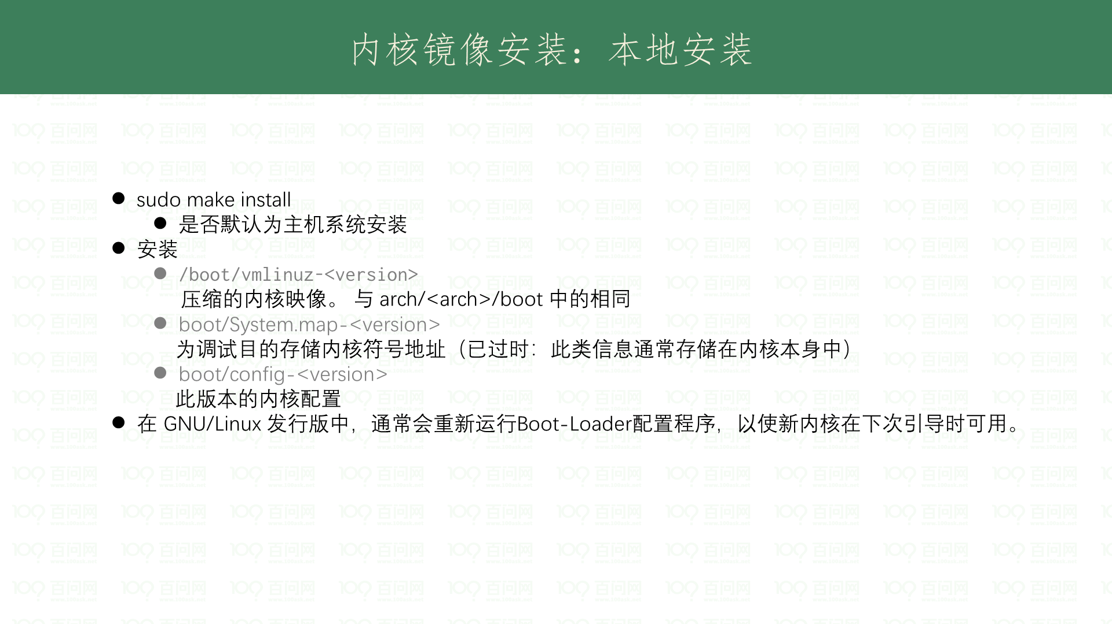

Slide 23
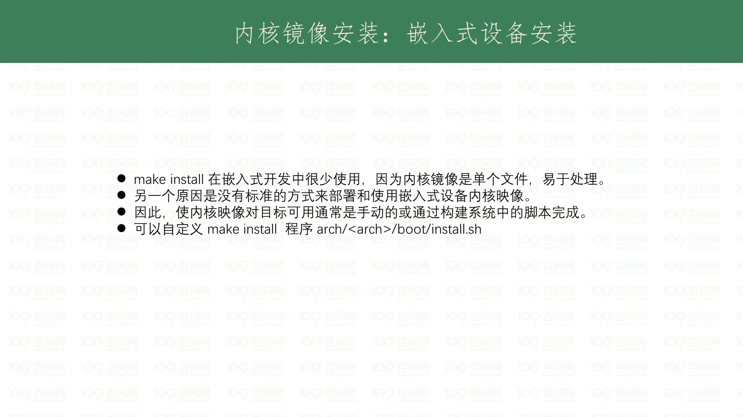

Slide 24
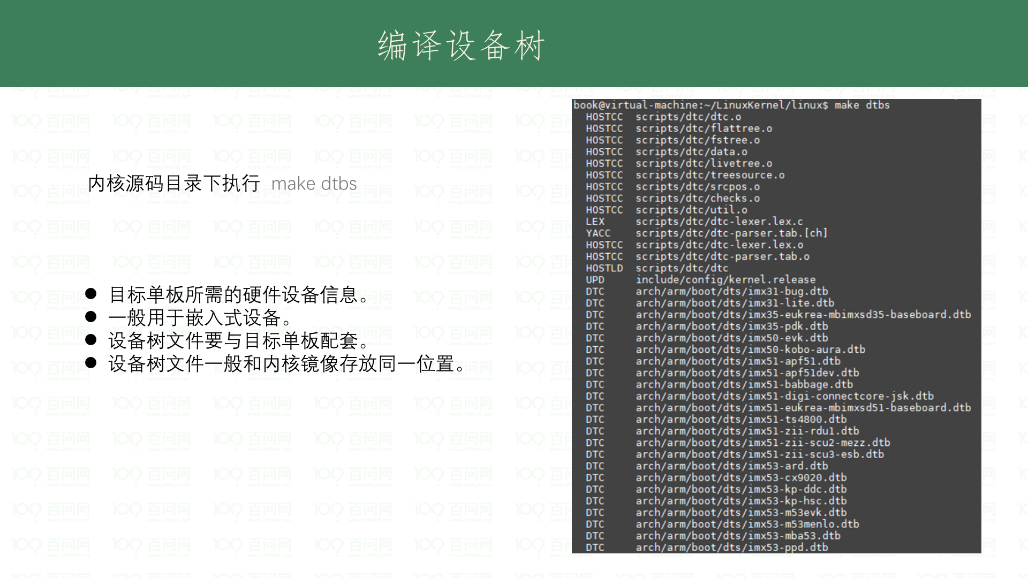

Slide 25
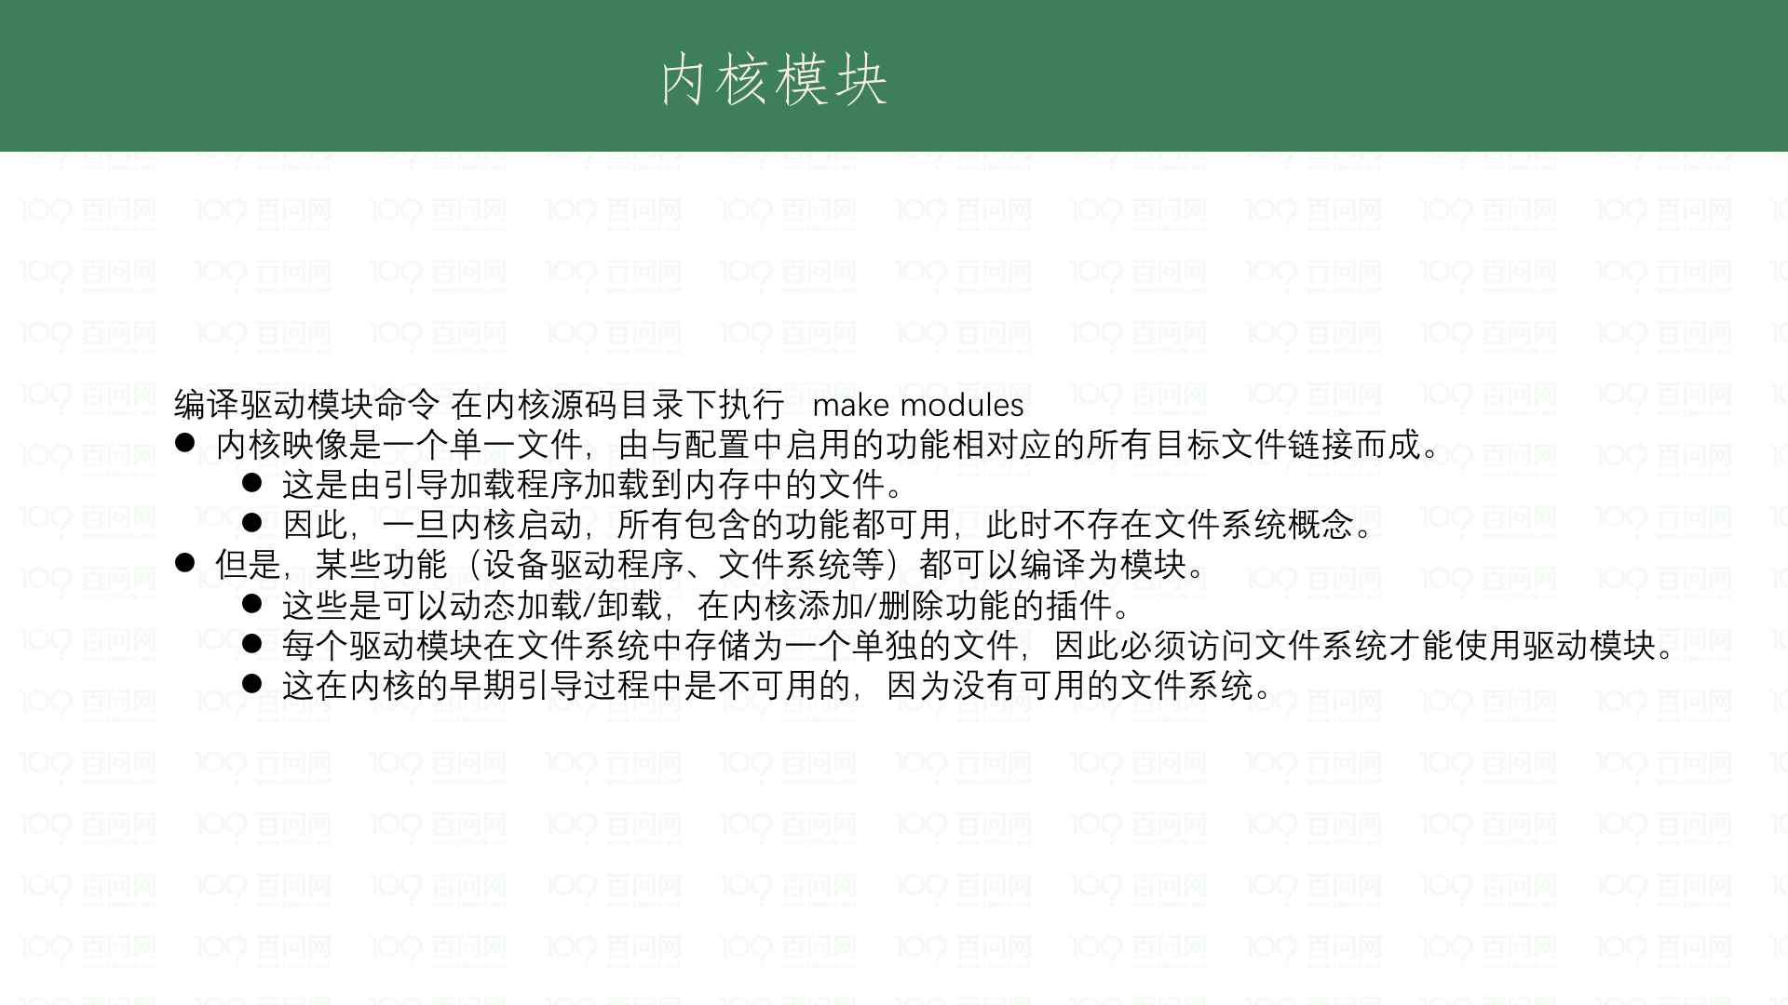

Slide 26
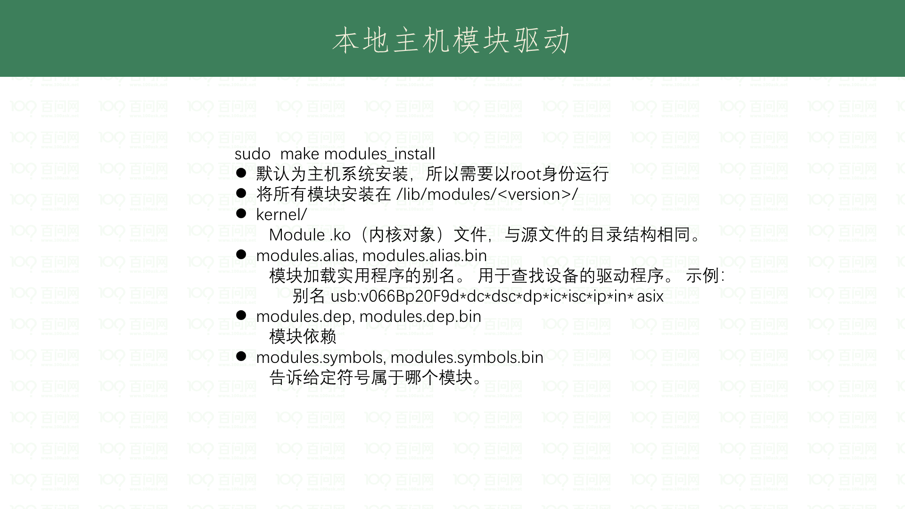

Slide 27
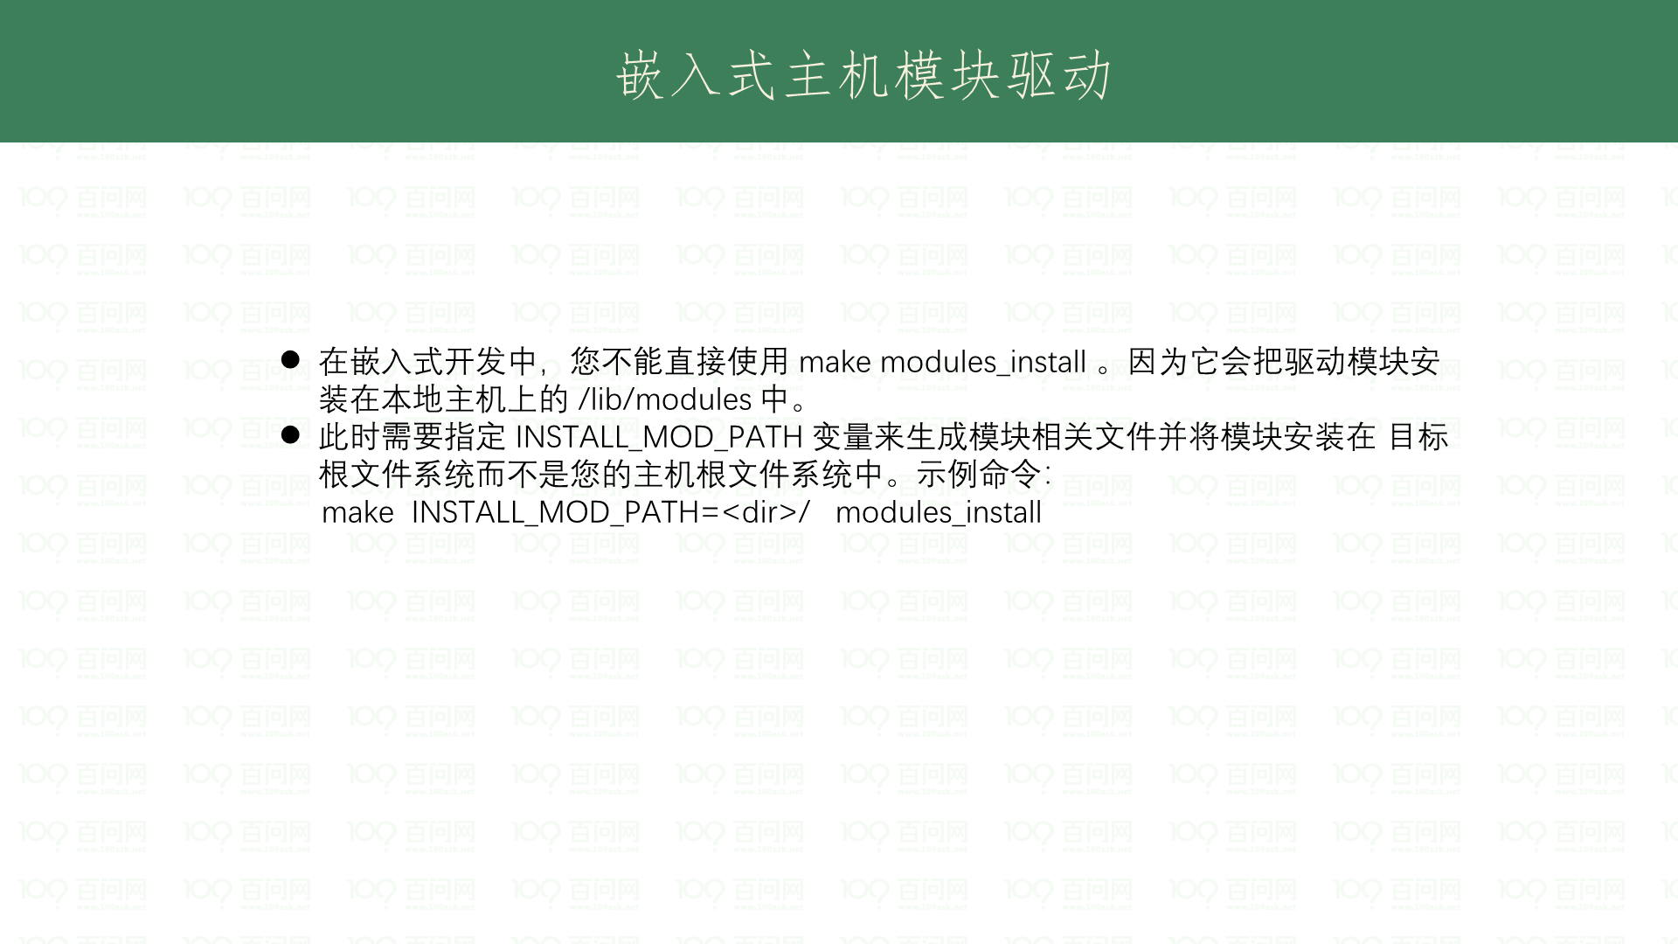

Slide 28
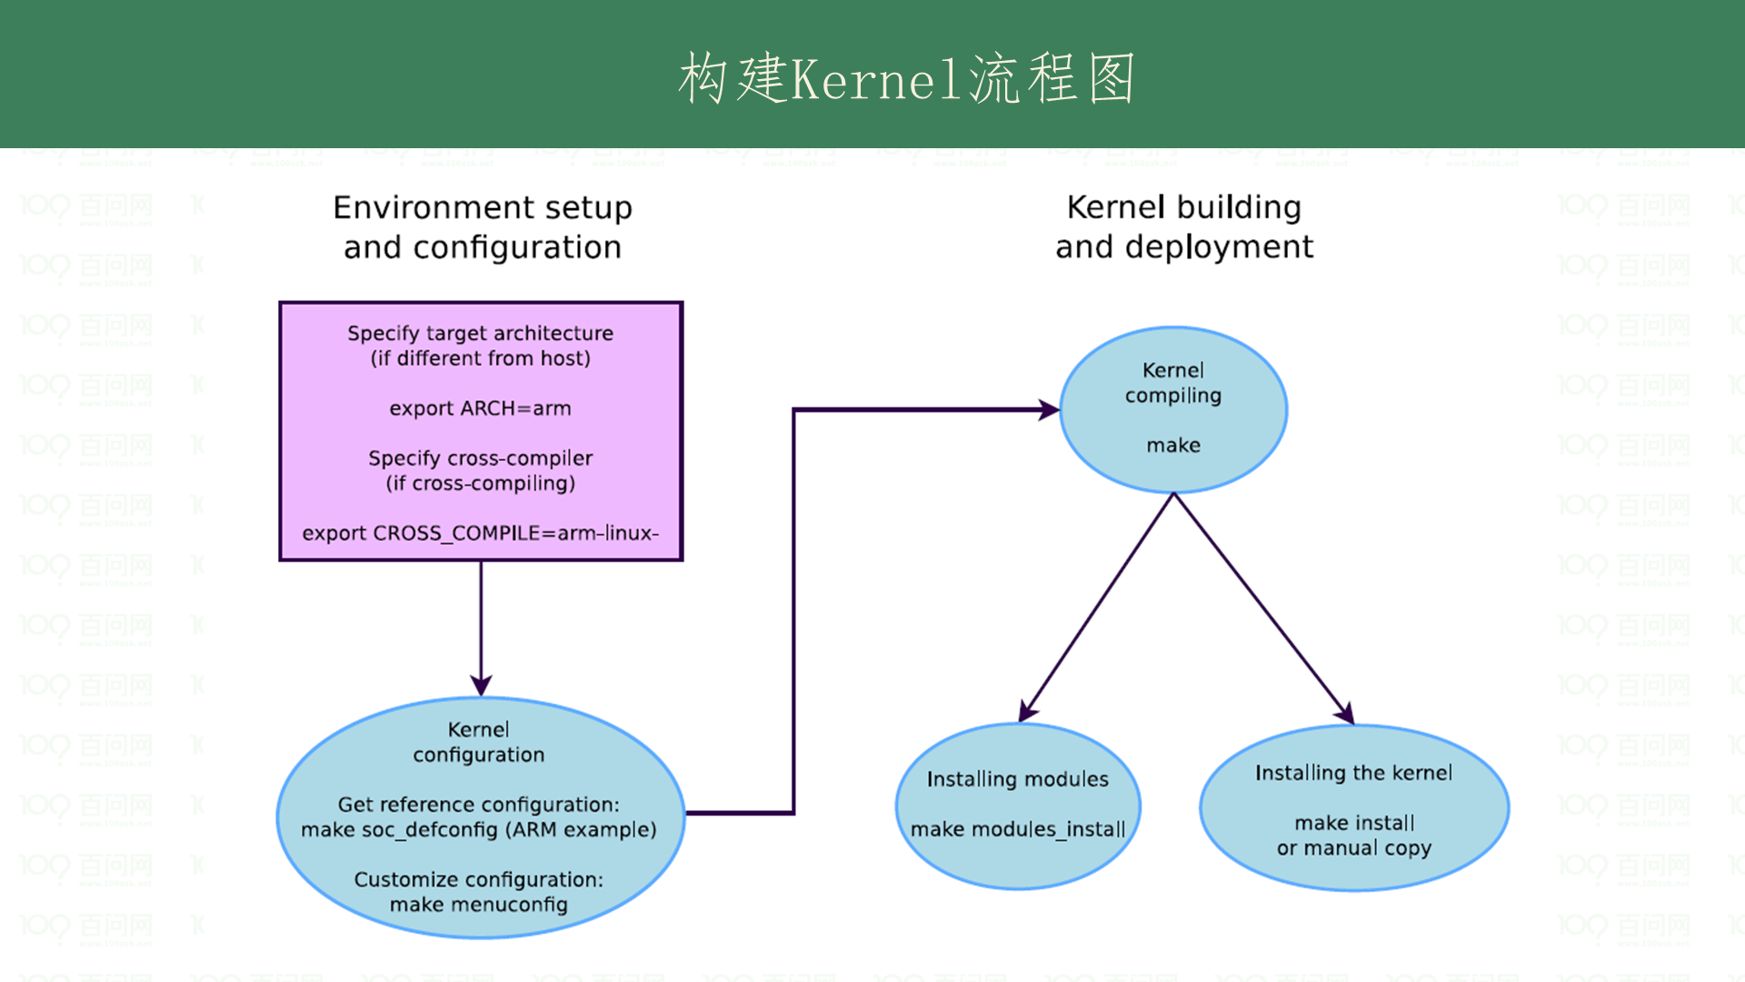
Notes:
sudo apt-get install gawk wget git diffstat unzip texinfo gcc-multilib build-essential chrpath socat libsdl1.2-dev xterm picocom ncurses-dev lzop

Slide 29
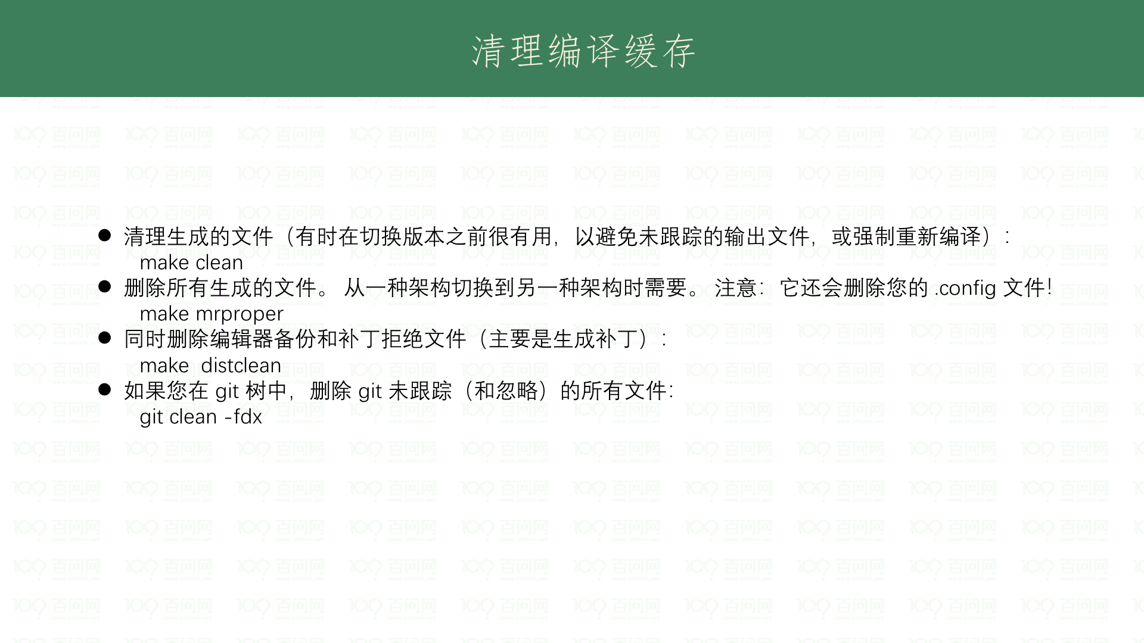

Slide 30
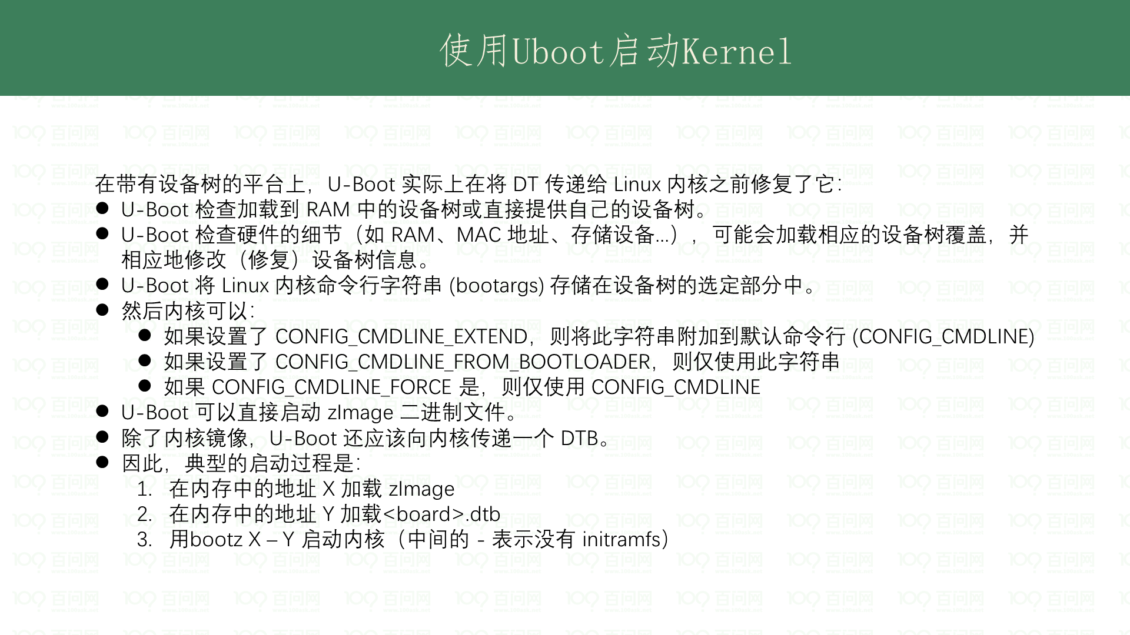
Notes:
sudo apt-get install gawk wget git diffstat unzip texinfo gcc-multilib build-essential chrpath socat libsdl1.2-dev xterm picocom ncurses-dev lzop

Slide 31
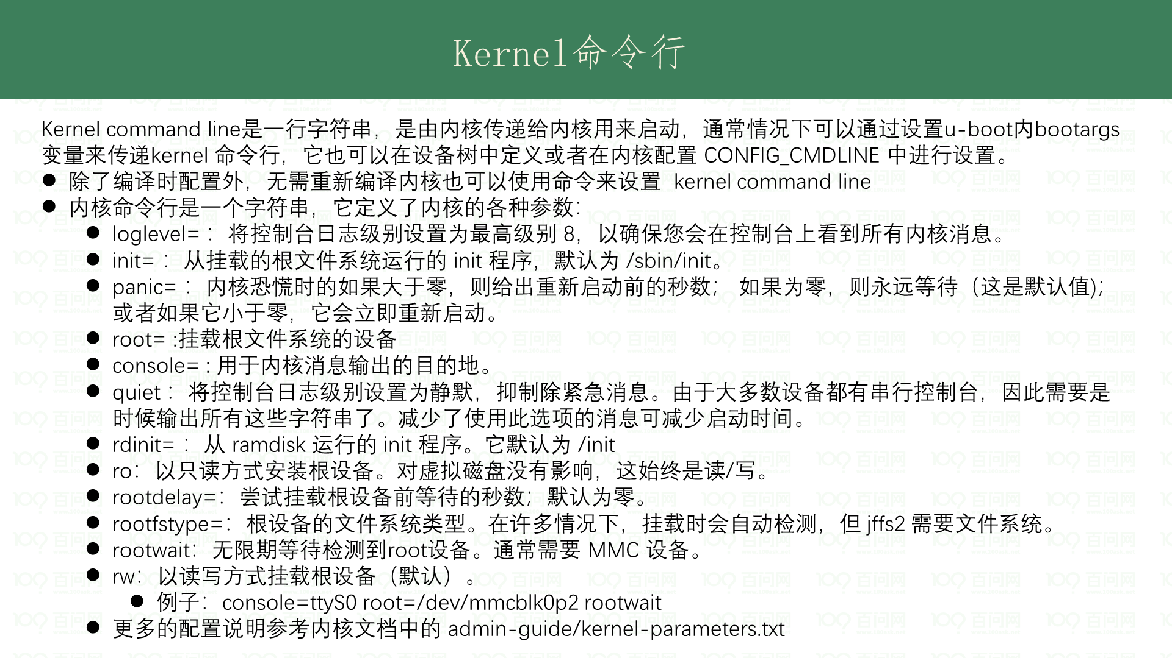
Notes:
The kernel log levels are: 0 (KERN_EMERG) The system is unusable. 1 (KERN_ALERT) Actions that must be taken care of immediately. 2 (KERN_CRIT) Critical conditions. 3 (KERN_ERR) Non-critical error conditions. 4 (KERN_WARNING) Warning conditions that should be taken care of. 5 (KERN_NOTICE) Normal, but significant events. 6 (KERN_INFO) Informational messages that require no action. 7 (KERN_DEBUG) Kernel debugging messages, output by the kernel if the developer enabled debugging at compile time.

Slide 32
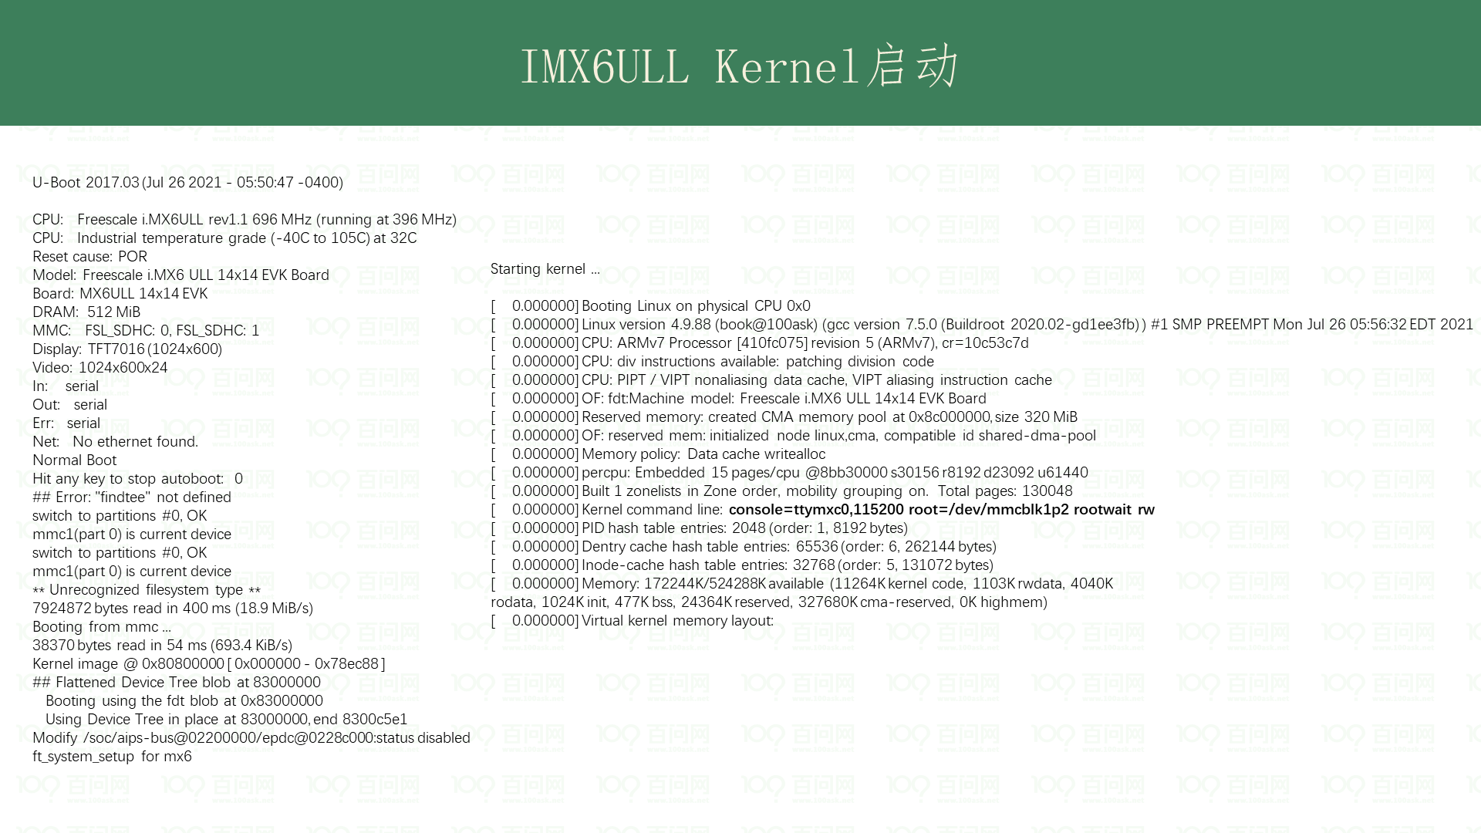
Notes:
sudo apt-get install gawk wget git diffstat unzip texinfo gcc-multilib build-essential chrpath socat libsdl1.2-dev xterm picocom ncurses-dev lzop

Slide 33
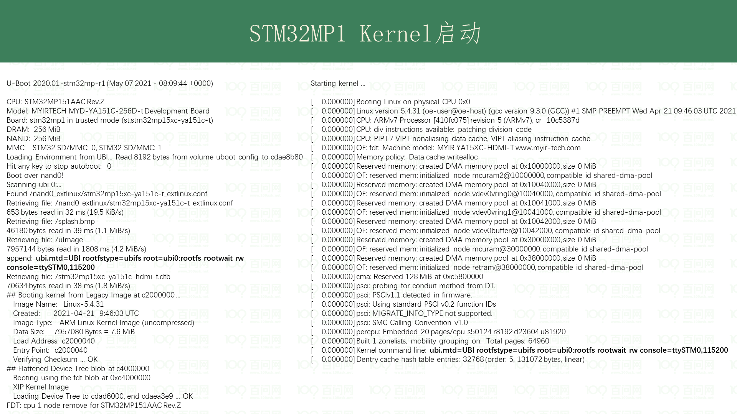
Notes:
sudo apt-get install gawk wget git diffstat unzip texinfo gcc-multilib build-essential chrpath socat libsdl1.2-dev xterm picocom ncurses-dev lzop

Slide 34
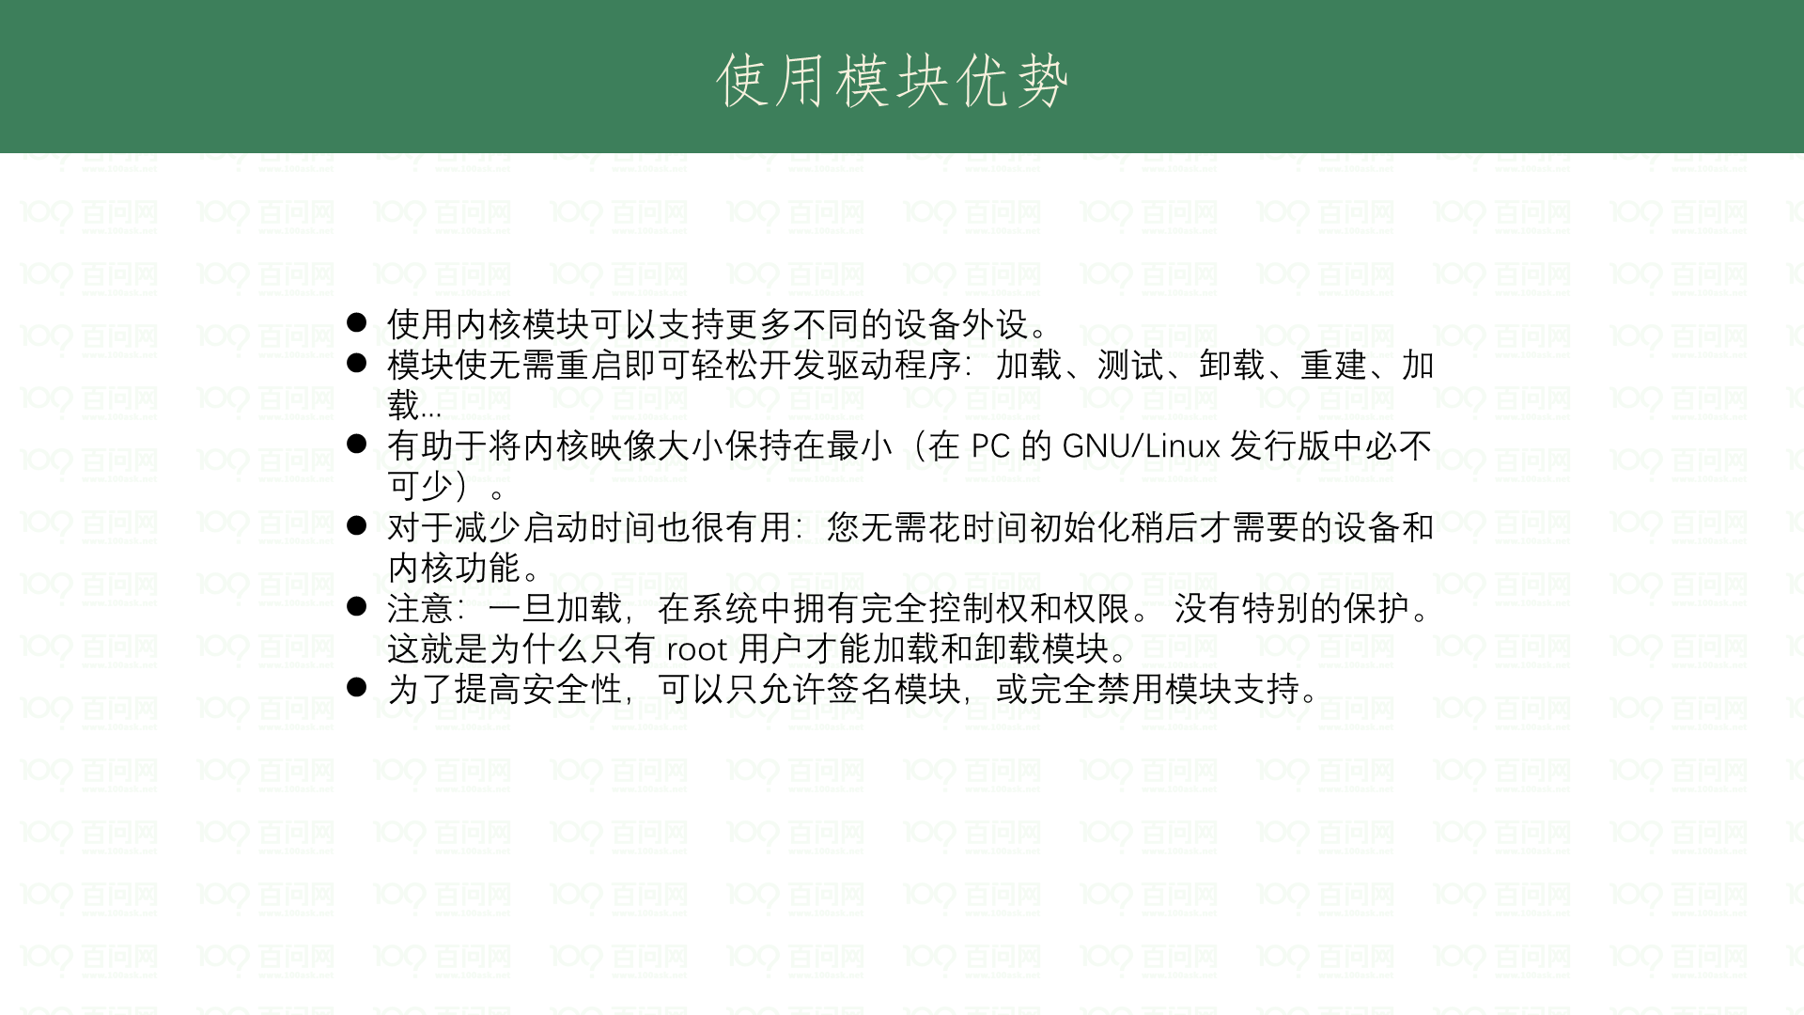
Notes:
sudo apt-get install gawk wget git diffstat unzip texinfo gcc-multilib build-essential chrpath socat libsdl1.2-dev xterm picocom ncurses-dev lzop

Slide 35
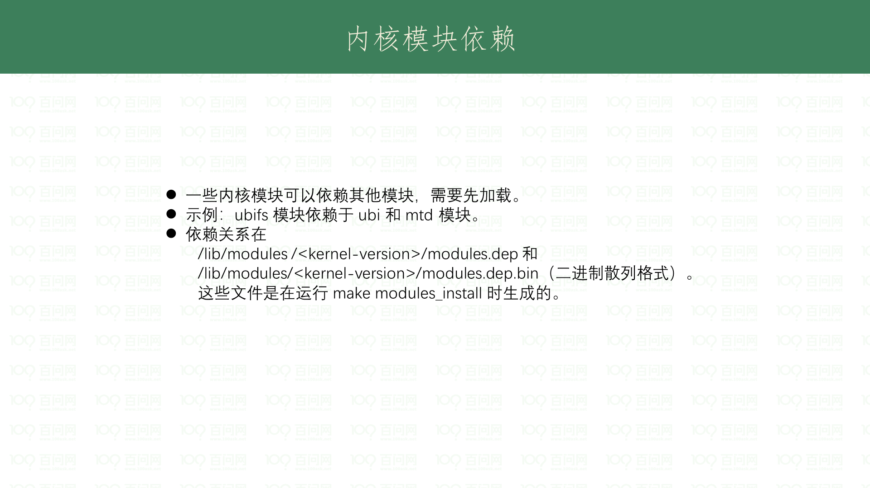
Notes:
sudo apt-get install gawk wget git diffstat unzip texinfo gcc-multilib build-essential chrpath socat libsdl1.2-dev xterm picocom ncurses-dev lzop

Slide 36
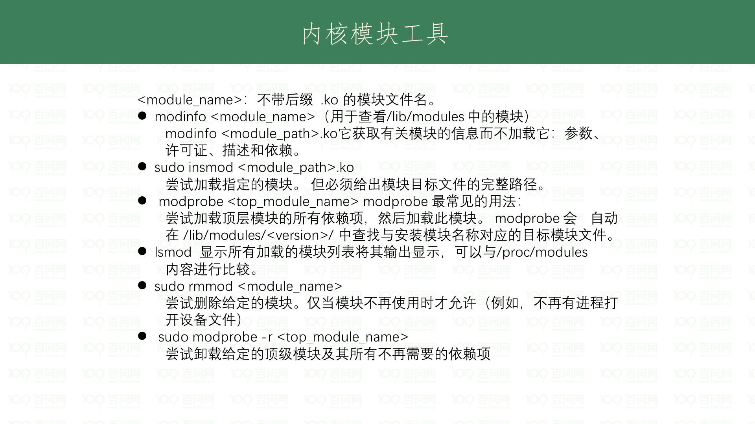
Notes:
sudo apt-get install gawk wget git diffstat unzip texinfo gcc-multilib build-essential chrpath socat libsdl1.2-dev xterm picocom ncurses-dev lzop

Slide 37
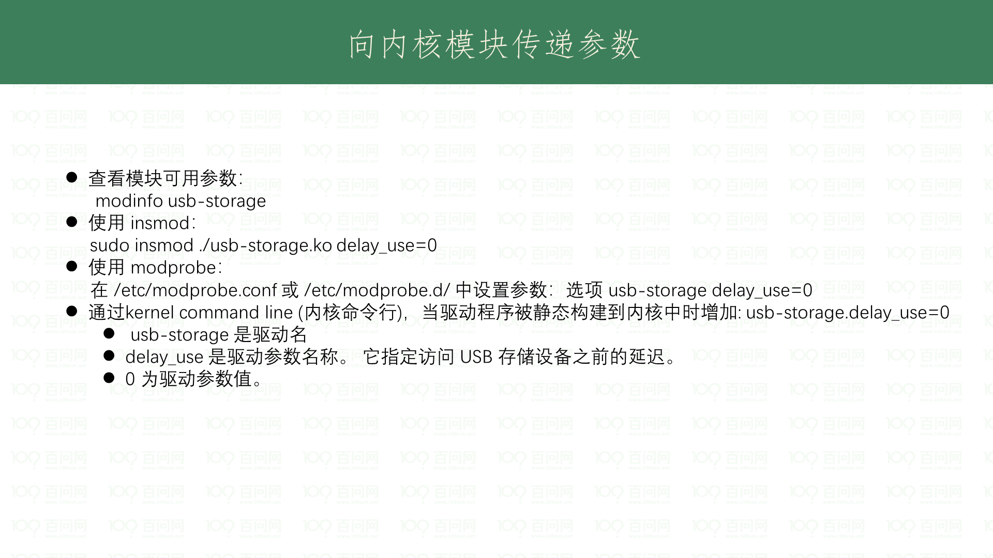
Notes:
sudo apt-get install gawk wget git diffstat unzip texinfo gcc-multilib build-essential chrpath socat libsdl1.2-dev xterm picocom ncurses-dev lzop

Slide 38
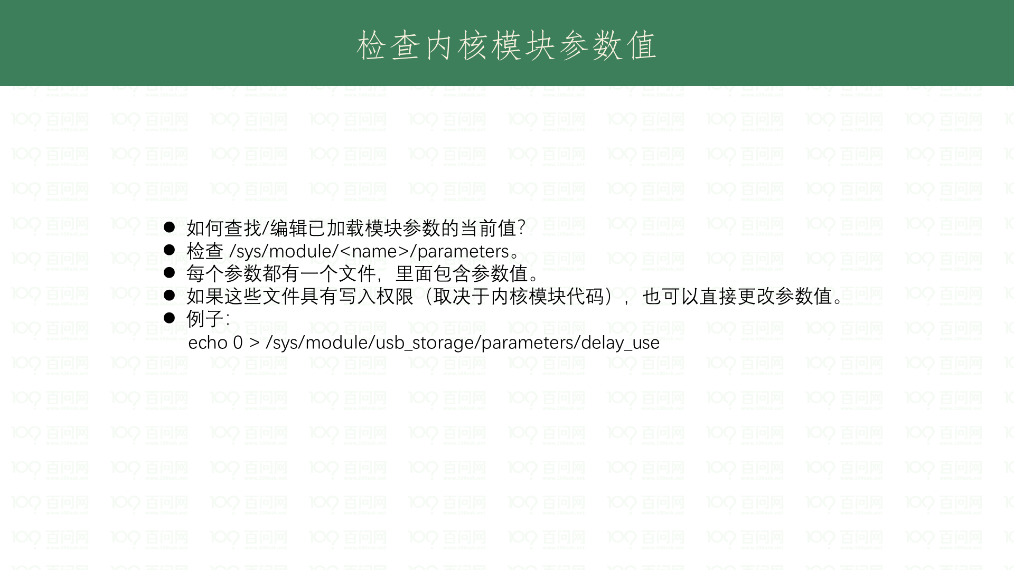
Notes:
sudo apt-get install gawk wget git diffstat unzip texinfo gcc-multilib build-essential chrpath socat libsdl1.2-dev xterm picocom ncurses-dev lzop

Slide 39
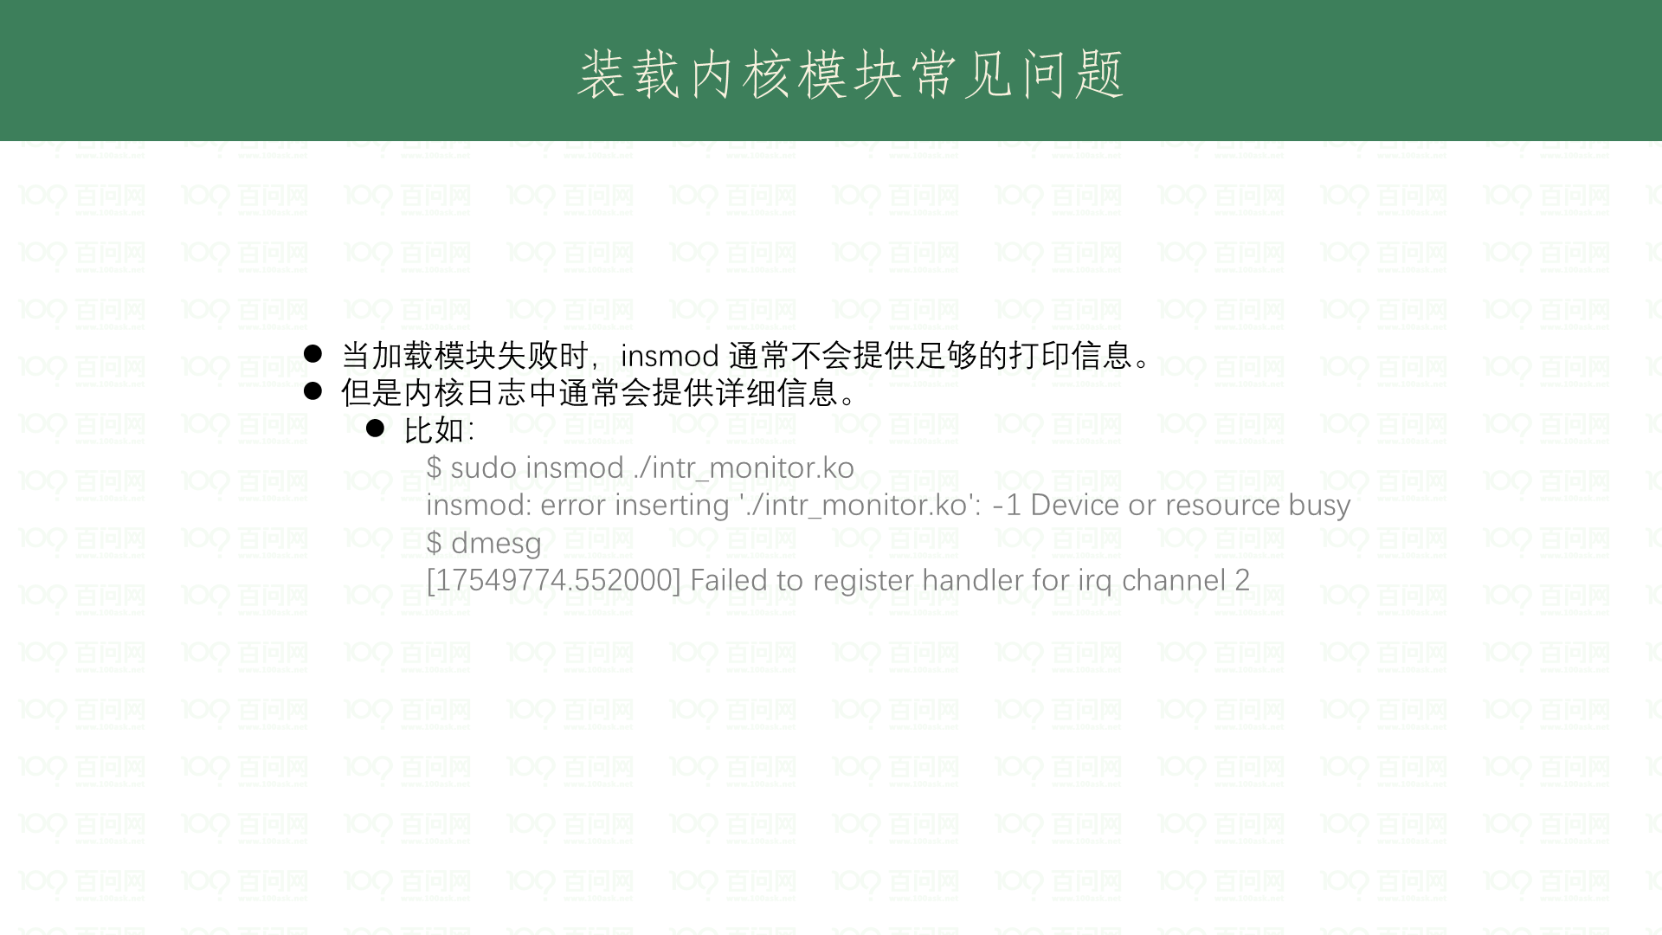
Notes:
sudo apt-get install gawk wget git diffstat unzip texinfo gcc-multilib build-essential chrpath socat libsdl1.2-dev xterm picocom ncurses-dev lzop

Slide 40
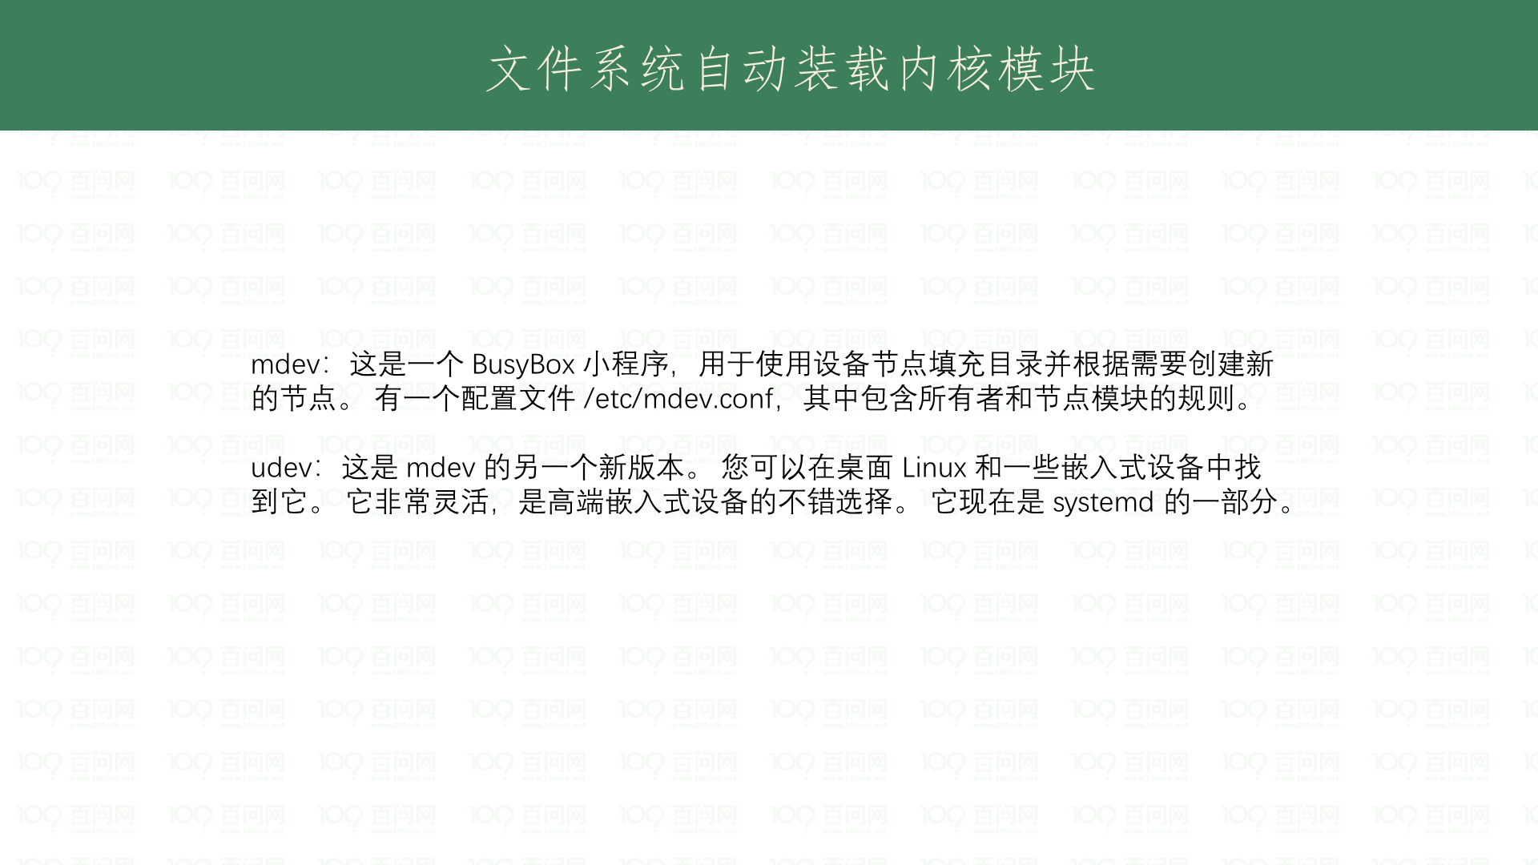
Notes:
sudo apt-get install gawk wget git diffstat unzip texinfo gcc-multilib build-essential chrpath socat libsdl1.2-dev xterm picocom ncurses-dev lzop

Slide 41
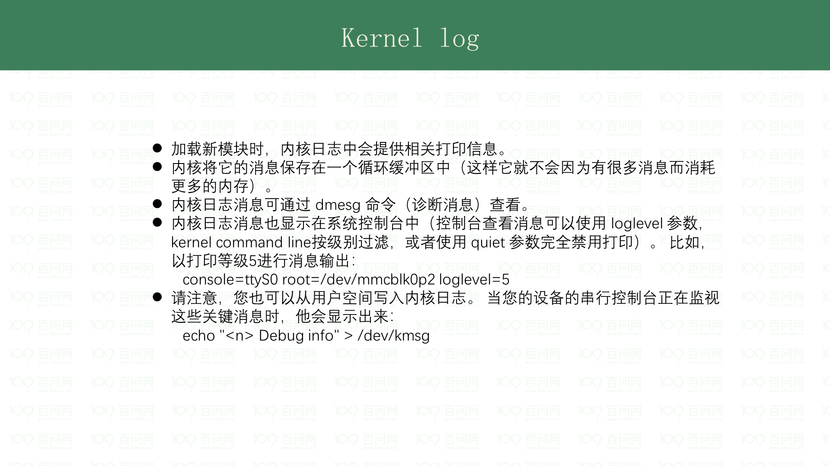
Notes:
sudo apt-get install gawk wget git diffstat unzip texinfo gcc-multilib build-essential chrpath socat libsdl1.2-dev xterm picocom ncurses-dev lzop

Slide 42
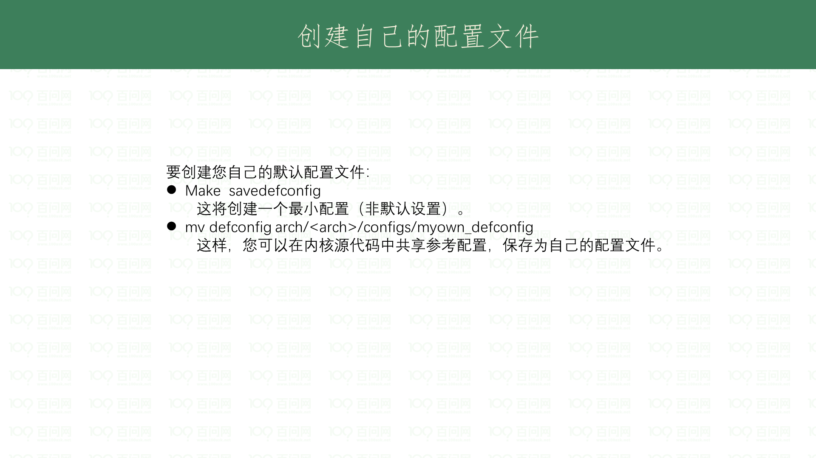

Slide 43
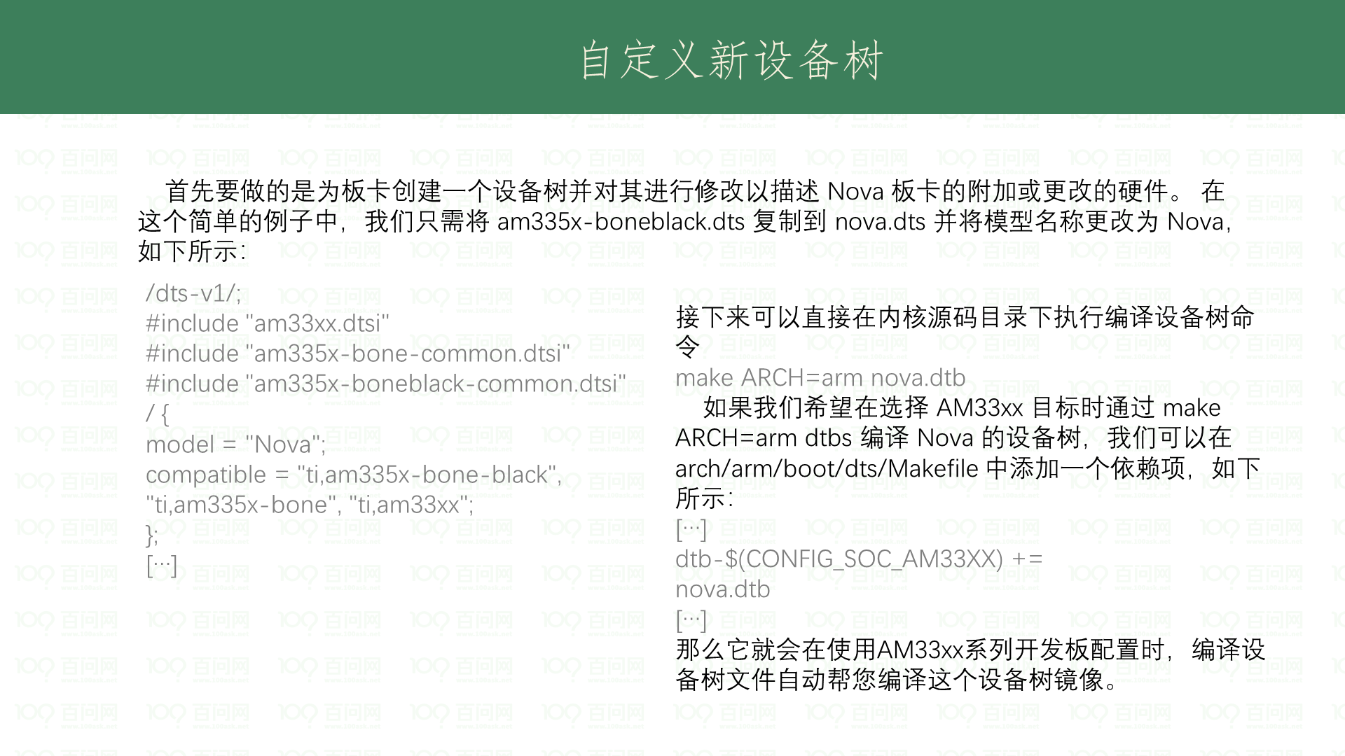

Slide 44
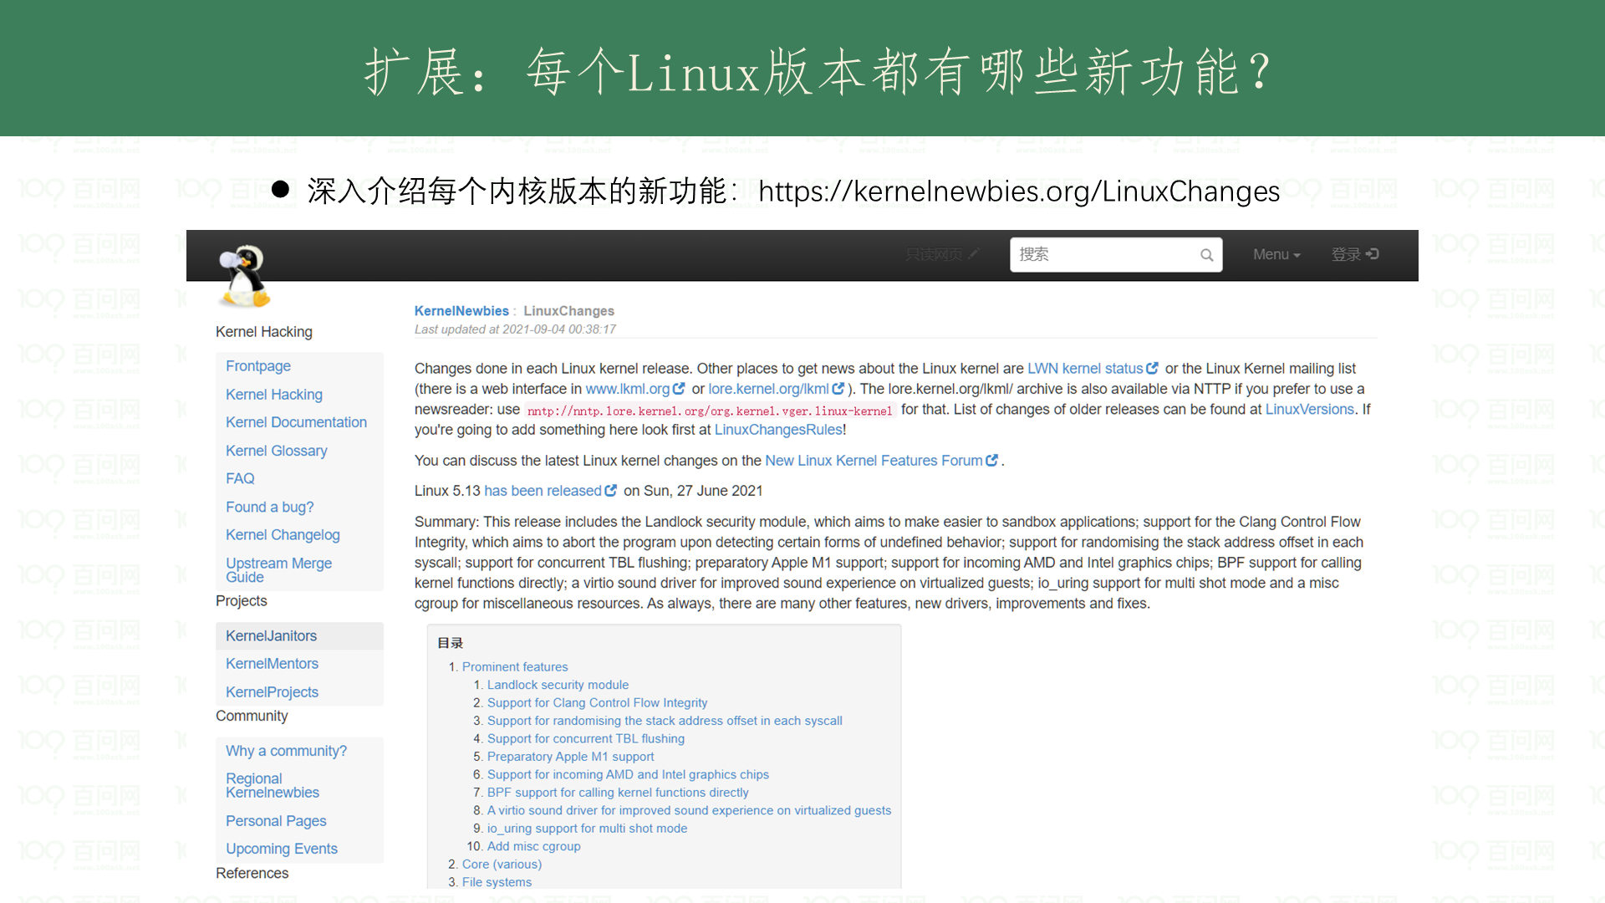

Slide 45
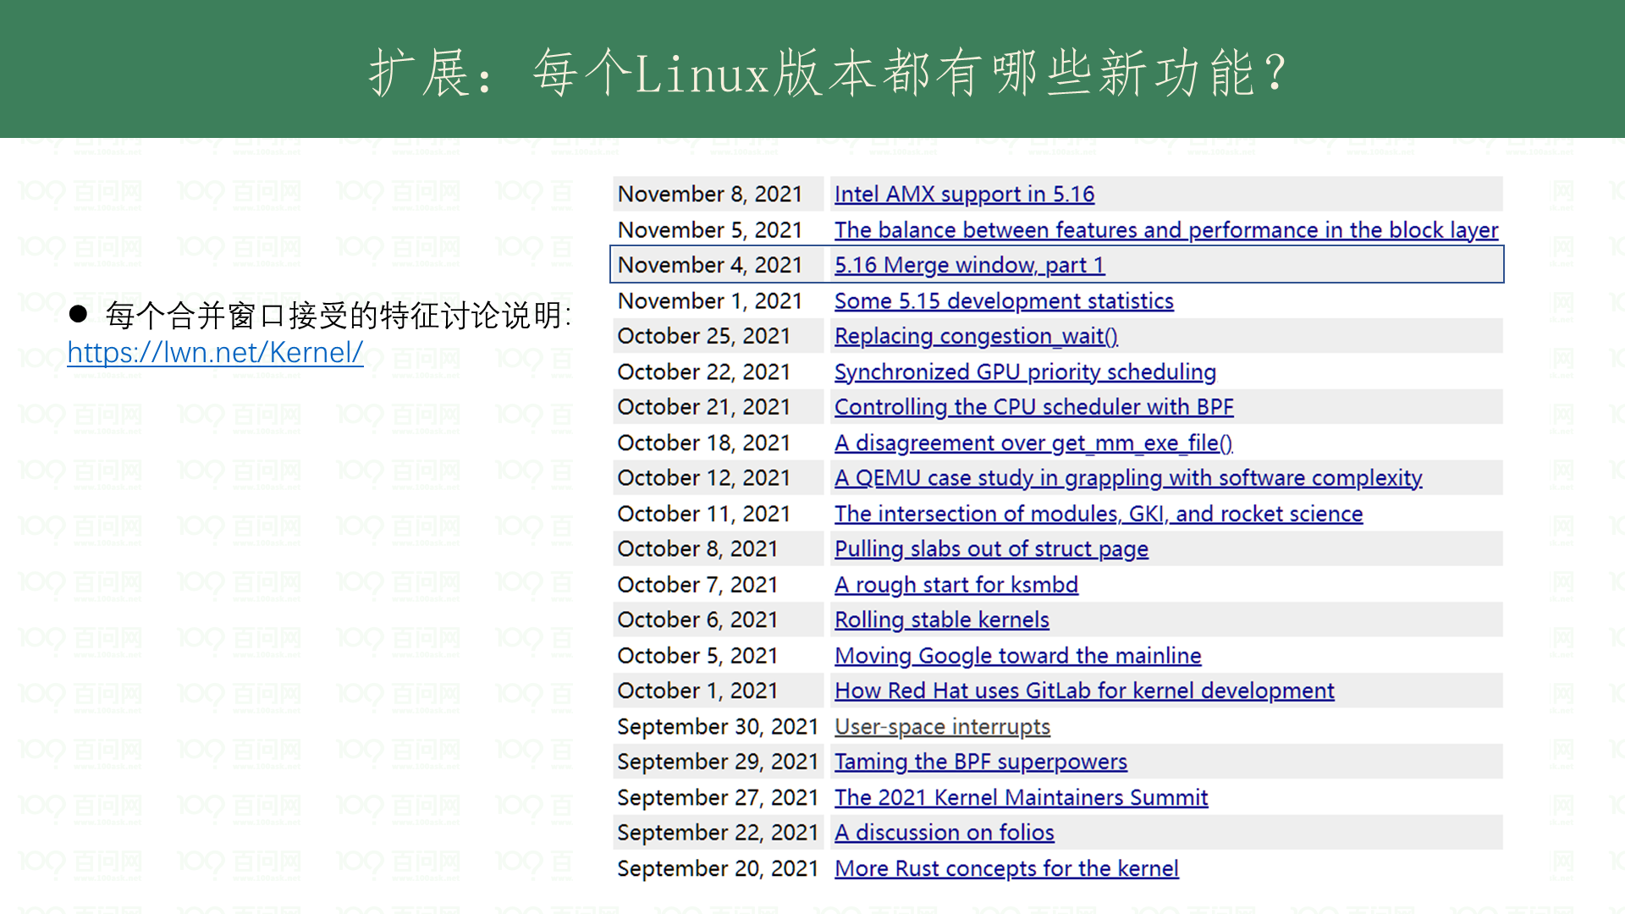

Slide 46
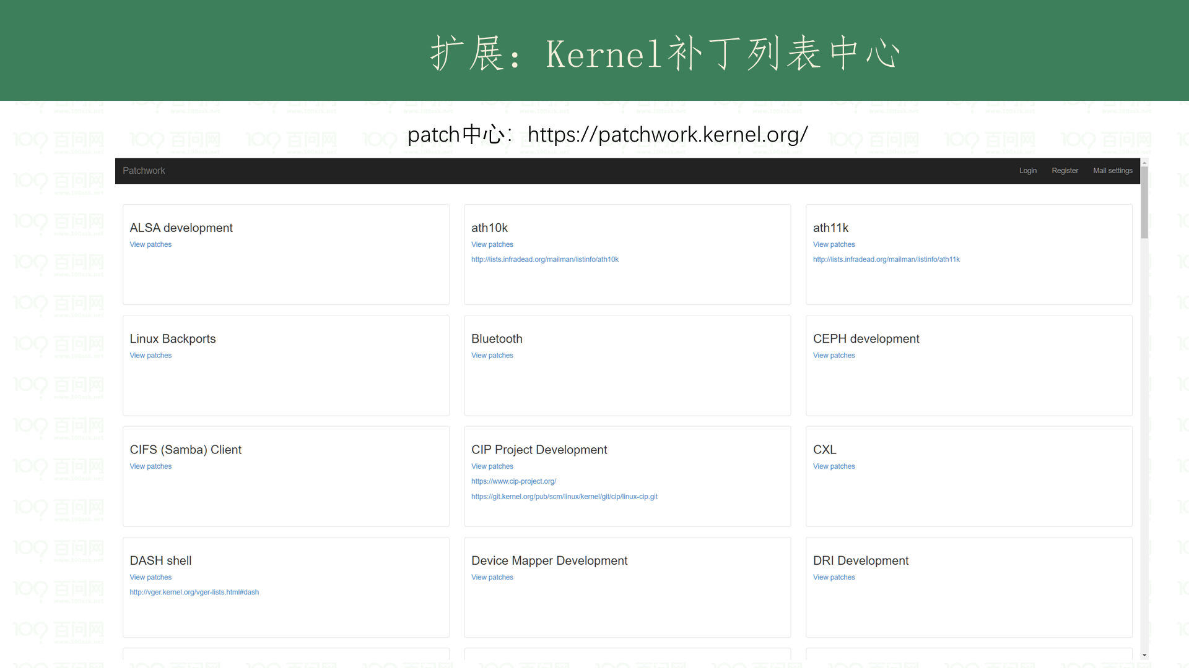

Slide 47
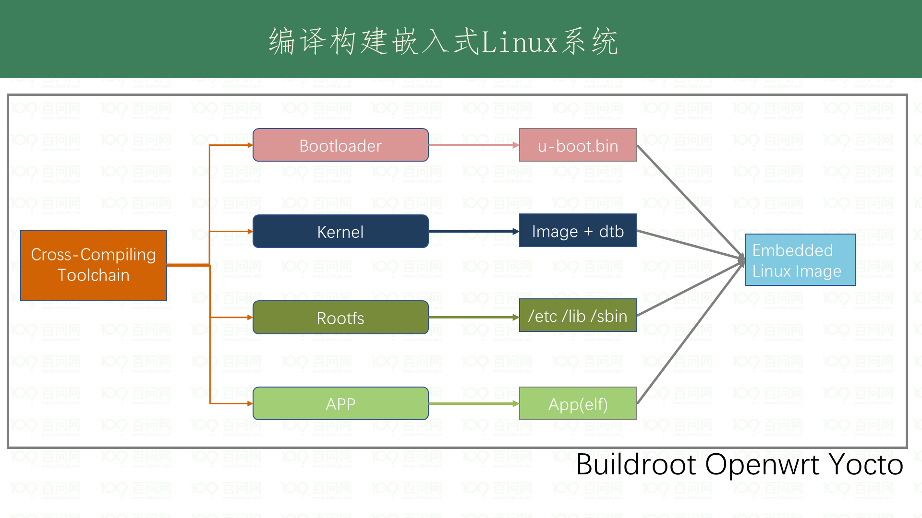

Slide 48
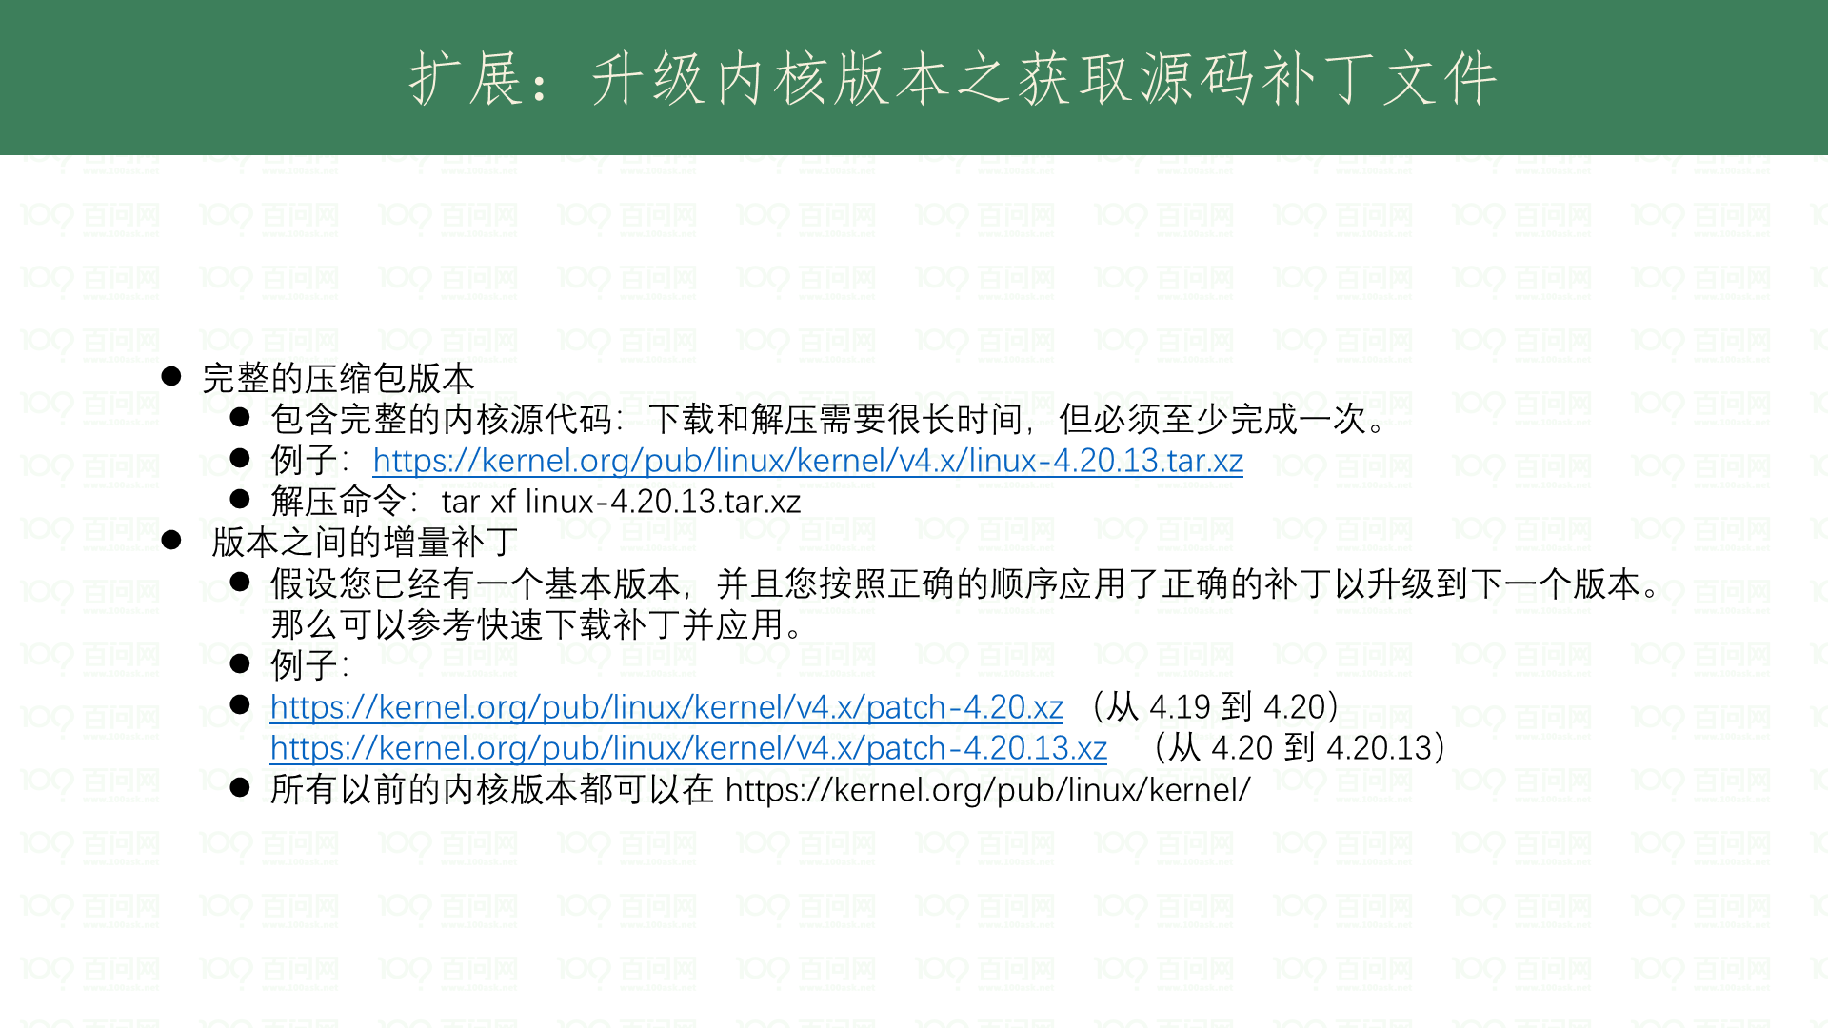

Slide 49
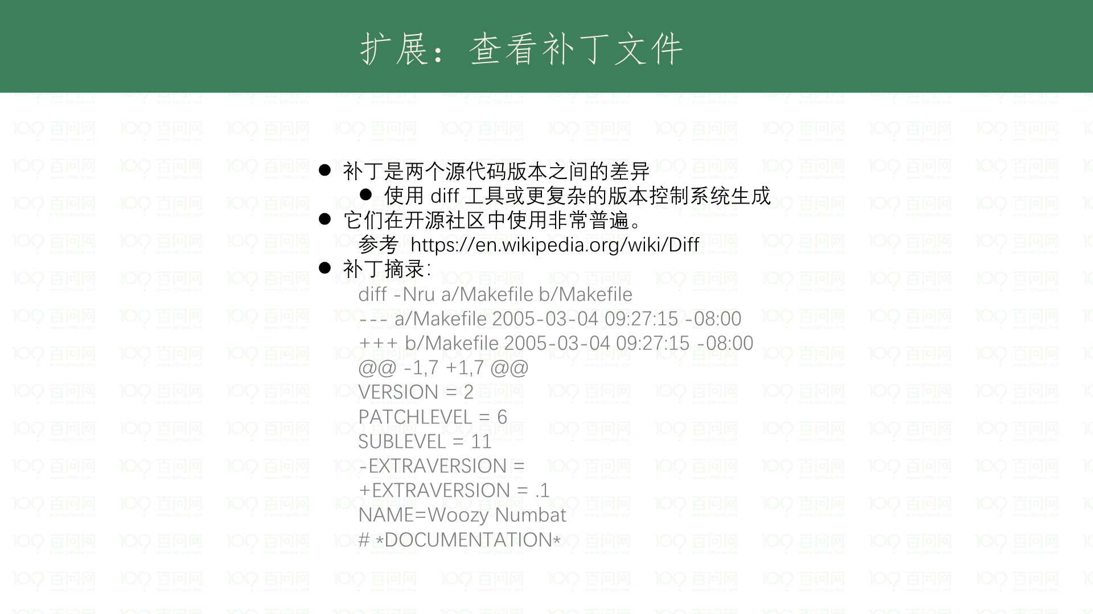

Slide 50
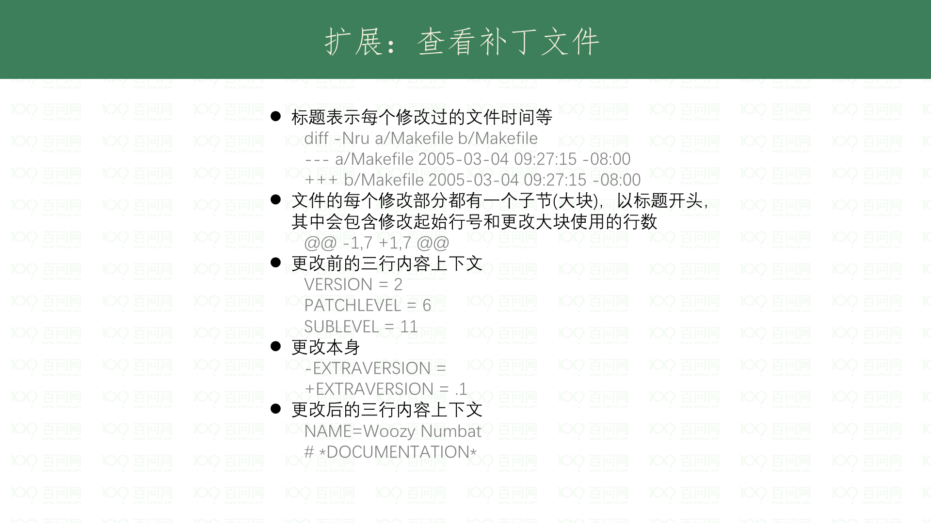

Slide 51


Slide 52


Slide 53

Notes:
参考 https://git-scm.com/book/zh/v2/Git-%E5%9F%BA%E7%A1%80-%E6%9F%A5%E7%9C%8B%E6%8F%90%E4%BA%A4%E5%8E%86%E5%8F%B2

Slide 54


Slide 55


Slide 56


Slide 57


Slide 58


Slide 59


Slide 60


Slide 61


